Slide 1
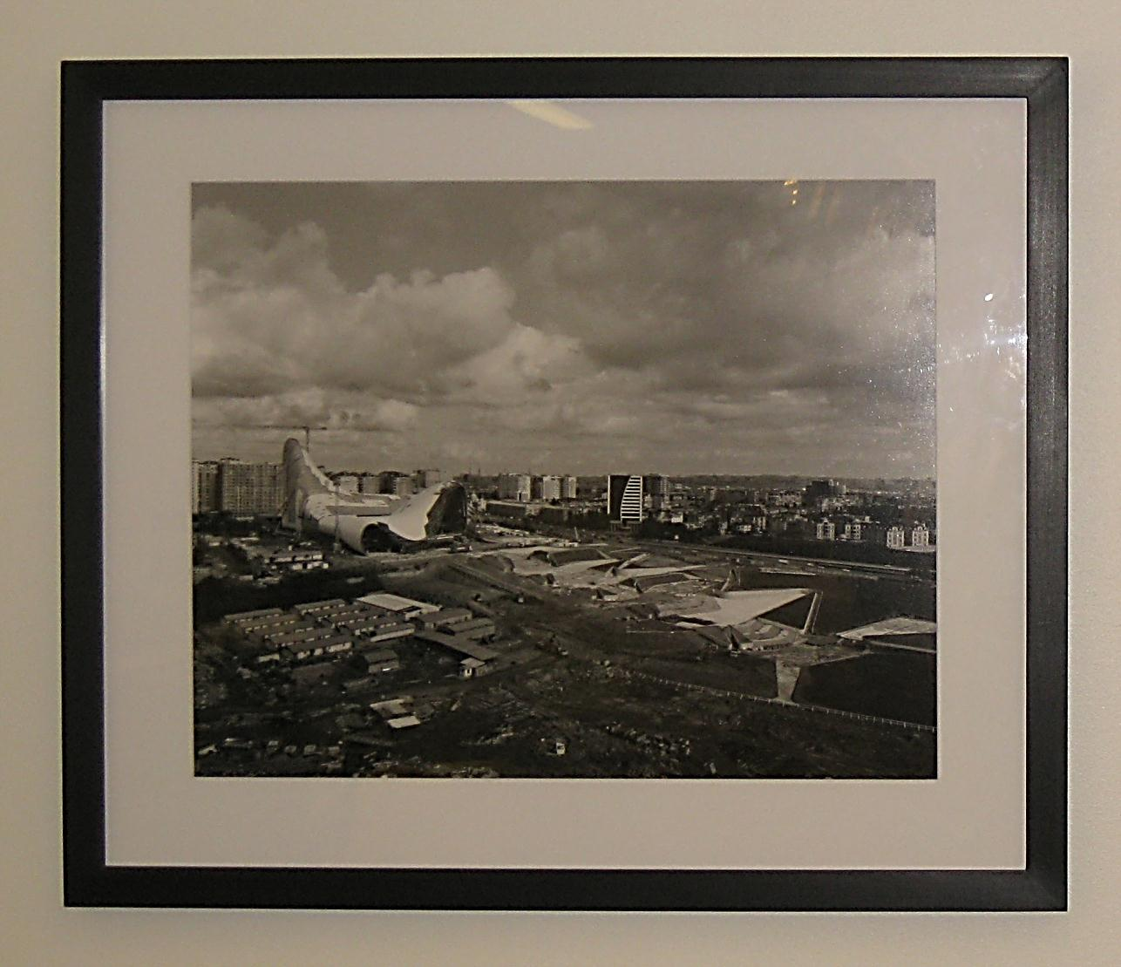
Matting and framing two dimensional documents and graphic works on paper
Black and White Photograph by Hélène Binet, Frances Loeb Library
IRINA GORSTEIN
MAY 1, 2012
MAY 1, 2012
IRINA GORSTEIN
Notes:
Good morning! I am very excited to be here today and to present to you a few tips on a rather large topic of matting and framing two dimensional objects.
I will be just skimming the surface in hope that today’s event is the beginning of a serious library-wide exhibition program.

Slide 2
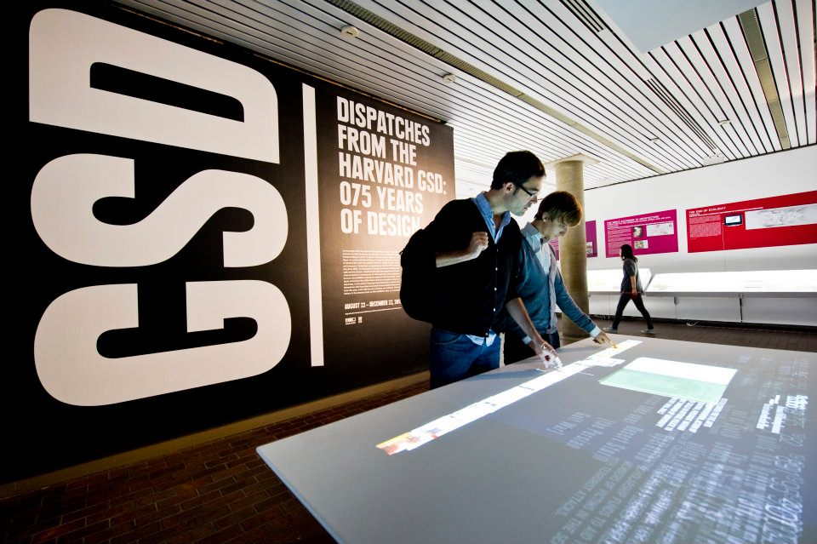
Image by Justin Knight
Notes:
My methods are catered to the exhibition space at the Graduate School of Design which is not climate controlled or particularly secure. However, we have a real Exhibitions program with dedicated staff and resources. Exhibitions play a significant role in the educational process and involve both faculty and students. My role is to make sure that exhibited original materials don’t get damaged. I hope that some of the methods and considerations presented today could be useful to the colleagues who are involved in exhibitions.

Slide 3
Things to consider
Notes:
When we receive a potential exhibition object, there are a few things that we have to take into consideration.

Slide 4
OVERALL CONDITION
brittleness
severe damage to edges
flaking of the media
sensitivity to light (photographic materials, colored graphic works, wood pulp papers)
Notes:
First step in exhibition prep is the overall condition assessment. Problems that might prevent the object from being exhibited are:

Slide 5
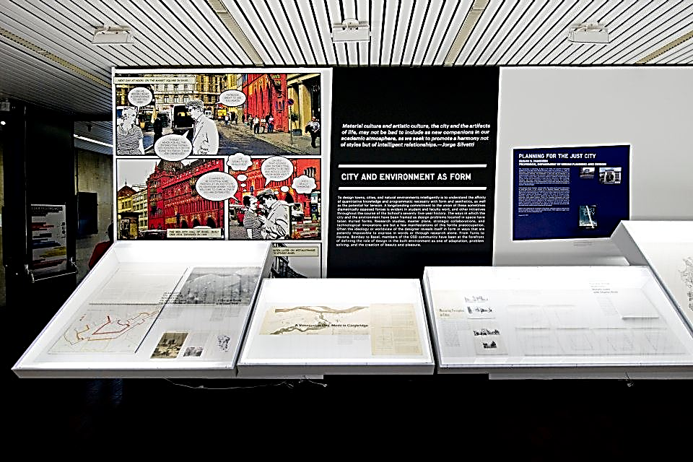
SAFEST DISPLAY METHOD
flat in the vitrine
framed
Image by Justin Knight
Notes:
The safest display method should be determined based on the condition assessment. Sometimes, a large and brittle object couldn’t be hung on the wall but could be displayed flat in a vitrine or on a table.

Slide 6
HARMFUL FACTORS
HOW TO CONTROL
light (high energy UV light is particularly harmful for archival materials)
unstable temperature and RH (rapid T and RH fluctuations are extremely damaging for most materials)
pollutants (both organic and inorganic, like dust, mold spores, gasses)
UV filtered glazing and low light levels
sealed package
archival grade materials and sealed package
Notes:
There are also a few harmful factors that we have to be aware of and to be able to control or minimize.

Slide 7
METHODS OF ATTACHMENT
Notes:
After we determined that the object can in fact be displayed, we have to decide on how to attach it to the mat.

Slide 8
NON-ADHESIVE (ALWAYS PREFERRED)
used when object can be over-matted and is relatively rigid with sturdy edges and corners
types
paper corners
paper strips
paper cradles
materials
acid-free paper that is easily foldable and holds the crease
pre-gummed tapes with acid-free carrier and neutral adhesive

Slide 9
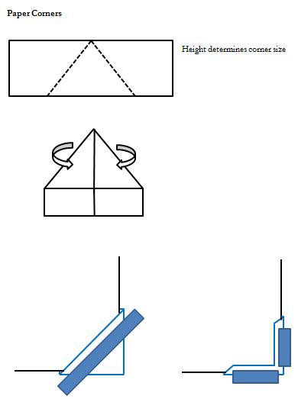
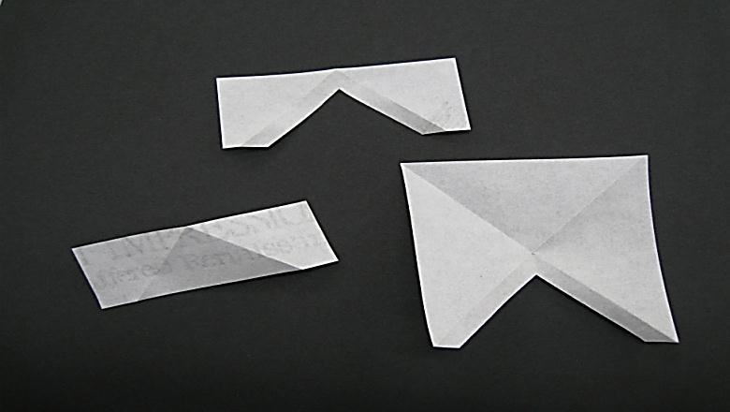
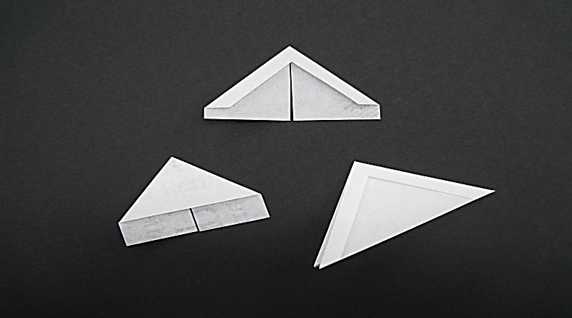
PAPER CORNERS
Notes:
Paper corners are most commonly known and easy to make. There are many types of paper corners but essentially you make either a full or a cut-out corner depending on how much overlap you can afford. The corners are anchored to the mat with pre-gummed tape. I usually stick a Mylar square into the corner to prevent moisture from getting on the object.

Slide 10
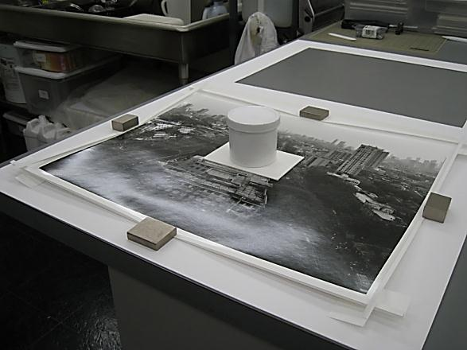
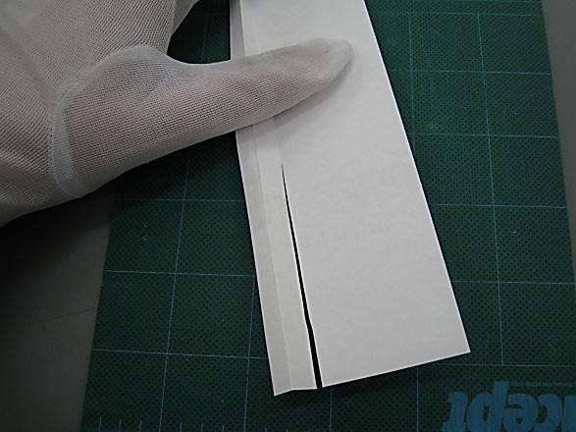
PAPER STRIPS
Notes:
Z-pleated paper strips work really well for most materials. They are essentially interlaced and that’s why the horizontal strips are cut along the inner crease.

Slide 11
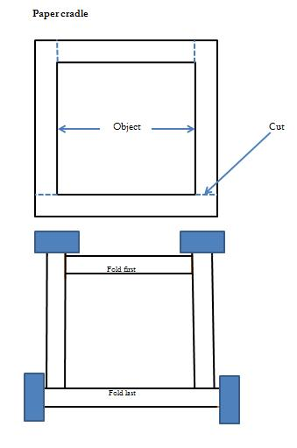
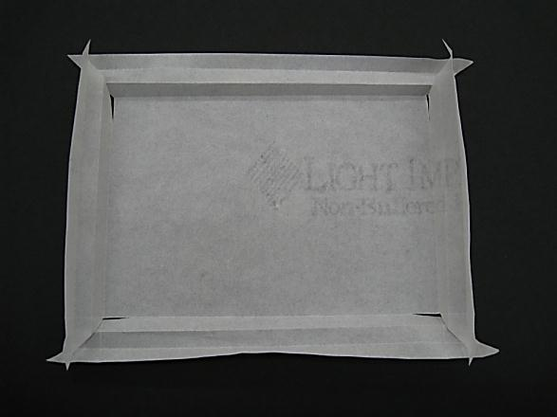
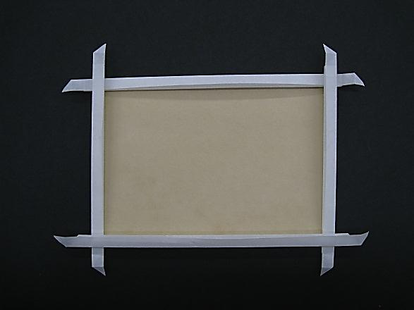
PAPER CRADLE
Notes:
Paper cradles or paper pockets are very useful and more supportive, especially if you have to create an isolation between the object and the mat. There is a diagram of a simple paper pocket with just one pleat. It works really well if you can afford a wider overlap. If I have to work narrow, the W-pleated cradle is better. You also make cuts in order to allow interlacing: horizontal at the bottom and vertical at the top.

Slide 12
ADHESIVE
used when object cannot be over-matted and also when substrate material is overly heavy or flimsy
types
hinges attached to the back of the object
false margins attached to the back along the edges of the object (for oversize and heavy objects)
materials
Japanese tissue or Korean paper: long fibered, neutral pH
wheat starch paste: reversible water-soluble adhesive

Slide 13
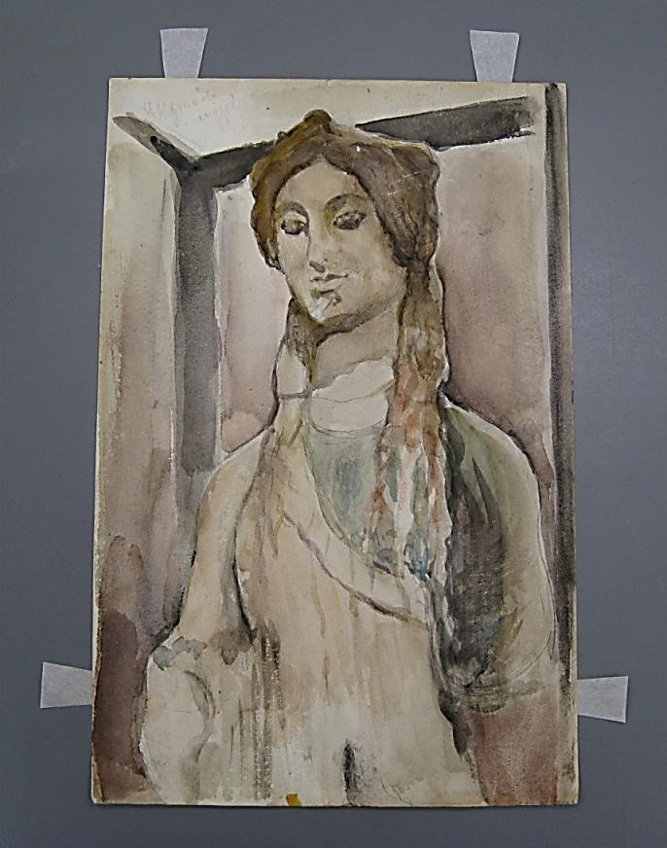
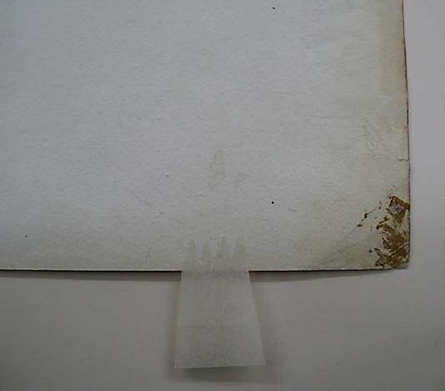
HINGING WITH JAPANESE TISSUE
application of hinges should only be performed by a conservator or an experienced technician
in most cases it’s better not to extend hinge more than ¼” in from the edge of the object
the width of the hinges should be proportional to the size of the object
placing the hinges
across the top edge
of the object is enough
in most cases
adding side hinges is
a good idea when the
whole object is exposed
with no overlapping window mat
Aquarelle by Valentin Serov, Collection of Irina Gorstein
Notes:
There are many ways of hinging. It all depends on the substrate and the size of the object. I learnt over the years that the hinge with cut out “teeth” works pretty well on most types of paper. The “teeth” minimize the adhesion area and therefore potential cockling and also they are visible and easier to remove than the hinge with water-torn edge.

Slide 14
Matting methods
Notes:
After non-adhesive mounts are made or hinges are attached and dry, it is time to mat.

Slide 15
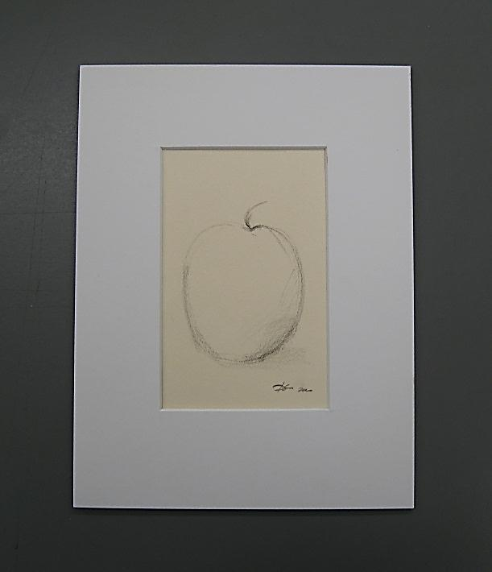
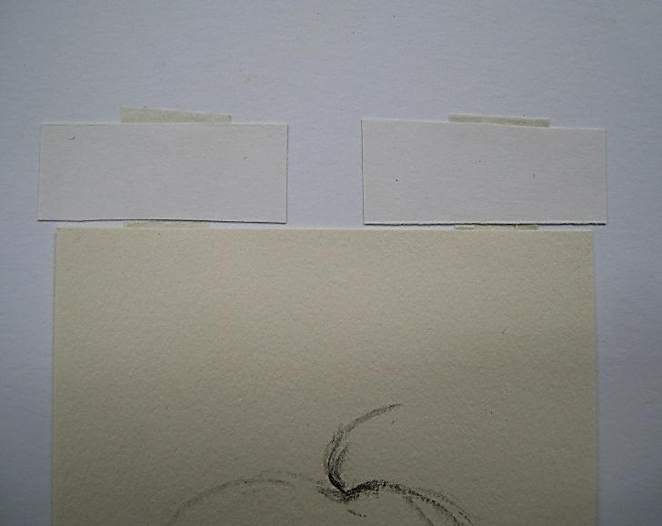
OVERLAPPING WINDOW MATS
used when edges of the object can be obscured with over- matting
materials
museum board: should be 100% rag or high alpha cellulose pulp and should pass PAT
pre-gummed tapes: acid free carrier and neutral adhesive
Notes:
Overlapping window mats are most common and also most secure.
The mat consists of two parts: top window mat and back mat to which the object is attached. The image on the bottom shows the hinged object being attached to the back mat with pre-gummed crossbar.
The Photographic Activity Test, or PAT, is an international standard test (ISO18916) for evaluating photo-storage and display products. Developed by IPI, this test explores interactions between photographic images and the enclosures in which they are stored.

Slide 16
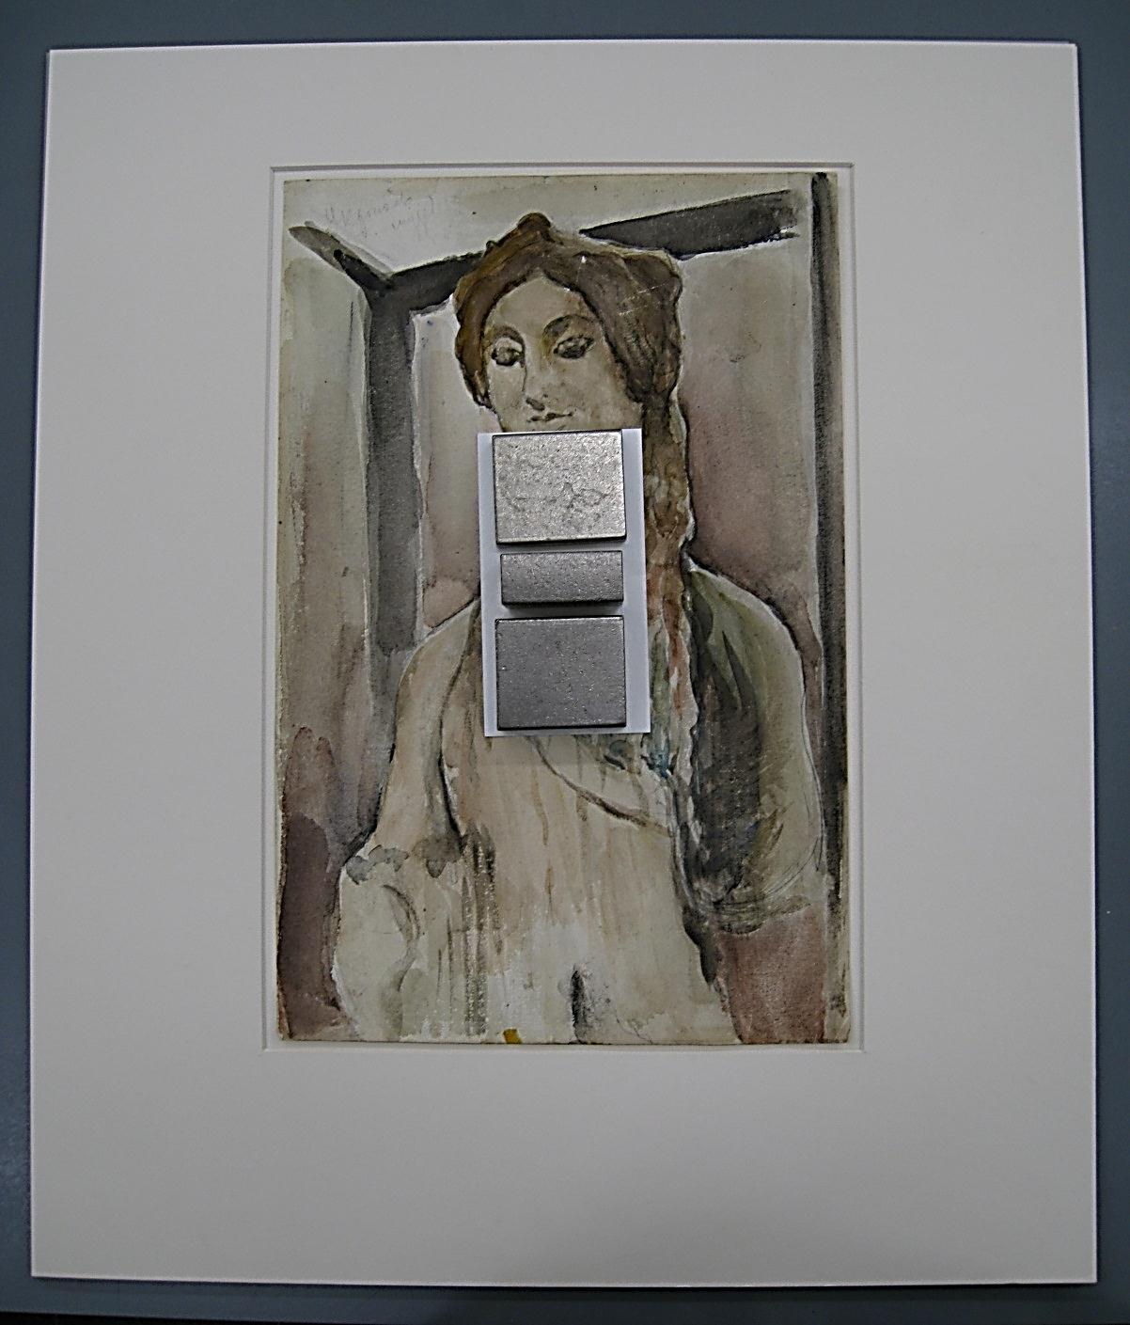
FLOAT MATTING
used when the object has to be displayed in its entirety

Slide 17
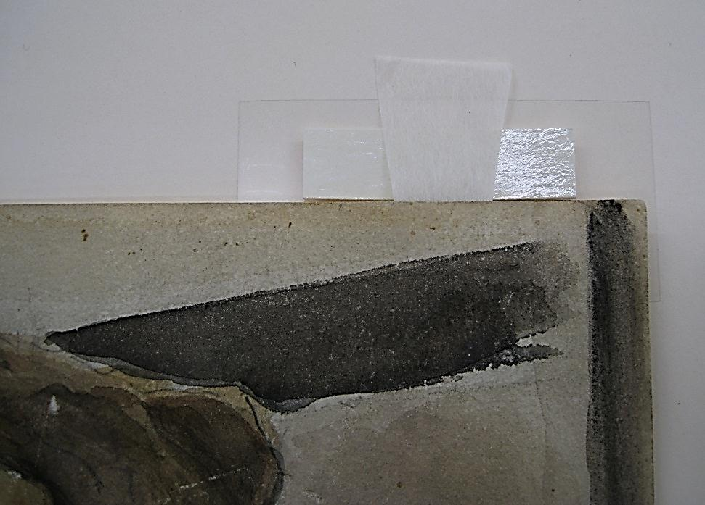
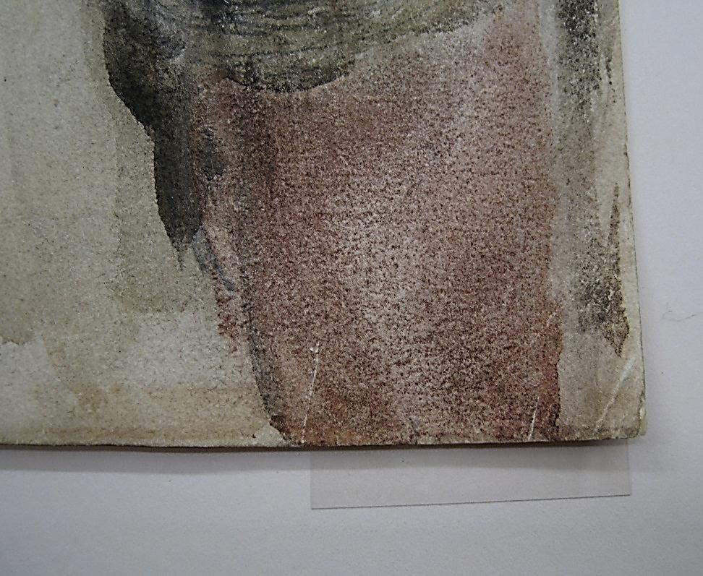
FLOATING THE OBJECT
it’s always advisable to stay away from the corners when attaching the hinge for floating because, if the hinge is close to the edge, after the hinge with the crossbar are folded back, the crossbar will be visible
Notes:
The moistened pre-gummed tape that serves as a crossbar is placed under the hinge adhesive side up. Both hinge and pre-gummed crossbar are then folded back behind the object and get adhered to the mat. A piece of Mylar should be inserted between the cross bar/hinge and the object in order to create a moisture barrier.

Slide 18
Framing
Notes:
After everything is mounted and dry, we can start framing. Materials’ choice for framing is rather important. Framing done right essentially creates a protective enclosure for your piece.

Slide 19
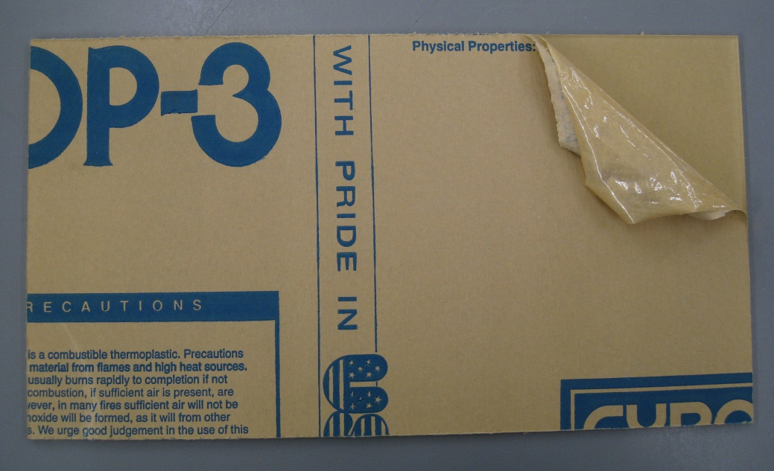
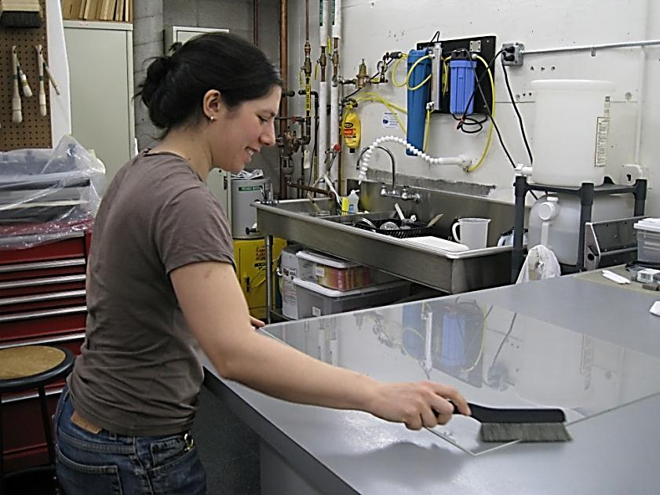
GLAZING
UV filtered acrylic glazing is generally preferred over glass
in many institutions glass glazing is forbidden for public display
Plexiglas is static and tends to warp
it should under no circumstances be put directly on top of object
Notes:
There are several types of acrylic glazing with slightly different qualities. At the Design School most of our framing is temporary. We also don’t reuse frames. We use Acrylite OP3 for our glazing needs (both for temporary vitrines and in the frames). It is UV filtered, not overly expensive and easy to get. This material comes with brown paper skin on both sides. It takes some time and effort to remove the protective paper and to clean it.

Slide 20
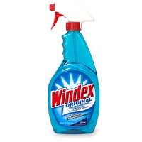
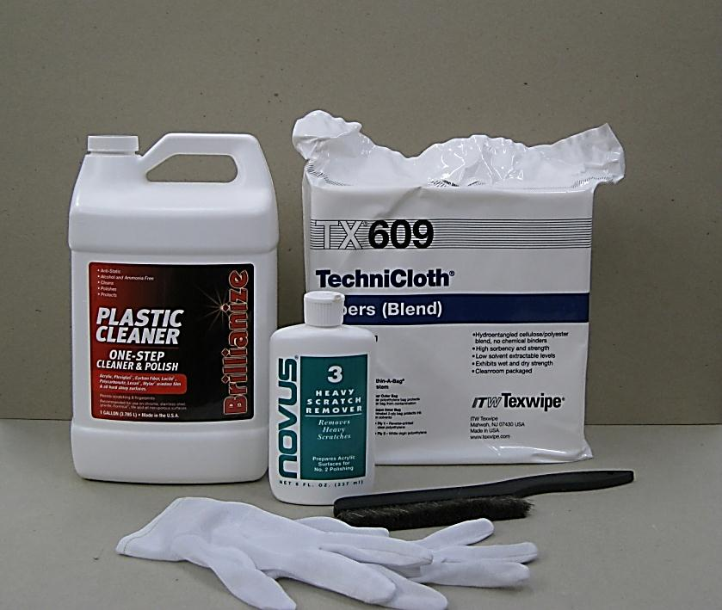
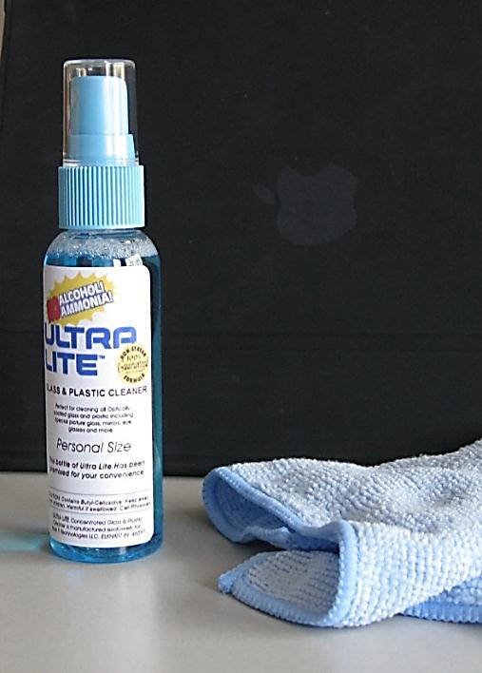
PLEXIGLAS CLEANING TOOLS
optically coated glazing shouldn’t be cleaned with ammonia-based cleaners like Windex because ammonia can dissolve UV coating
Notes:
Plexi should be cleaned with antistatic plastic cleaner on both sides, as well as brushed with static dissipating brush. The slide in the middle shows some materials that I use for cleaning Acrylite OP3. I just want to mention Optium as a glazing choice. It’s less static, more stable to humidity changes and is preferred by museums for their framing needs. However, it’s more expensive and requires slightly different handling. The recommended cleaner for it is Ultra Lite shown on the right hand slide. It should be sprayed on a microfiber terrycloth rather than directly on the glazing.

Slide 21
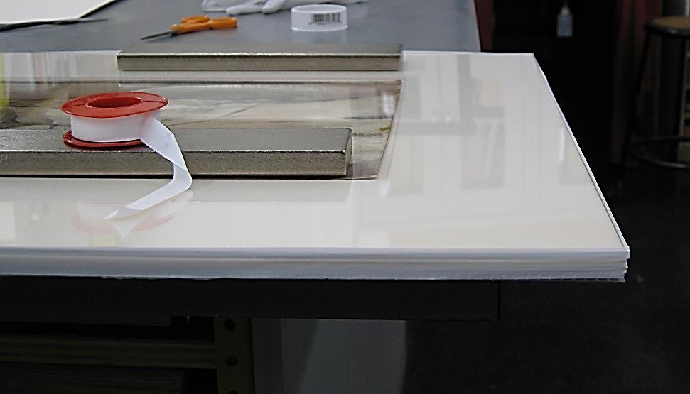
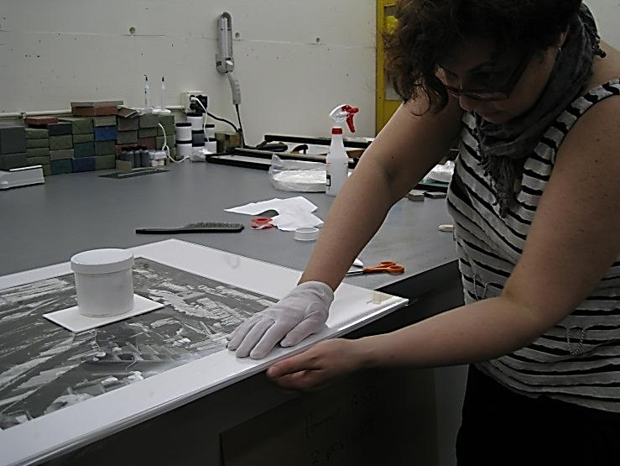
MAKING A SEALED PACKAGE
TEFLON TAPE WRAPPED AROUND THE EDGES
Image by Joanna Vouriotis
Notes:
I mentioned sealed packages before. They are great for keeping everything in place, for keeping the dust out and for creating a micro-chamber environment within the frame. Because the exhibition space at the GSD is not climate controlled, I make sealed packages for everything that gets framed. The choice of backing material is rather important. It should be pH neutral and it should pass PAT. I like to use Coroplast which is corrugated plastic. I just make sure that it comes from conservation supplier so that it’s free of plasticizers and coatings. The matted object is sandwiched between the glazing and the backing and sealed with pressure-sensitive adhesive tape. For that it is first assembled and placed on a bench face up. This way I can see if there is dust inside so that I can lift Plexi and remove it. I then use Teflon tape as a barrier for protecting the edges of the mat from the Framer’s tape adhesive. Paper or Tyvek are good choices too. Teflon is great because it clings to itself. It just has to be wrapped around the edges and pressed down.

Slide 22
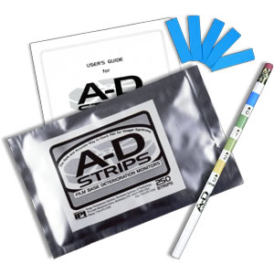
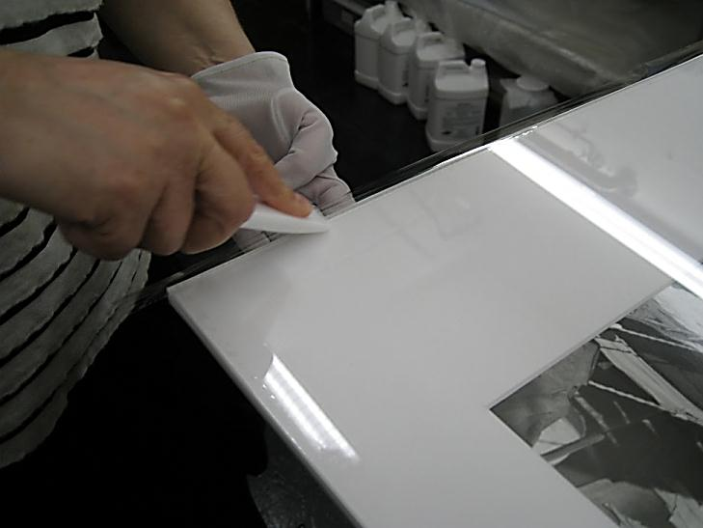
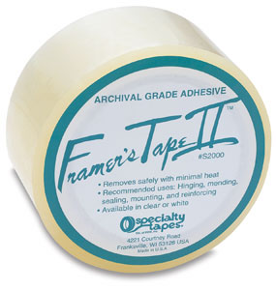
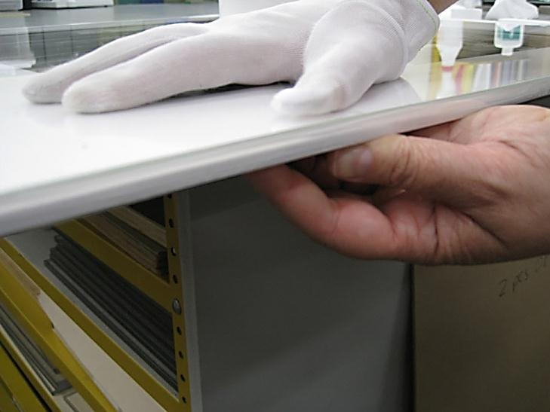
SEALING PACKAGE WITH FRAMER’S TAPE II
Image by Joanna Vouriotis
Image by Joanna Vouriotis
Notes:
For sealing tapes the reversibility is important; tapes should be tested with A-D strips (Acid Detectors) for presence of acetic acid. Actual sealing is pretty straightforward. I use Framer’s Tape II.

Slide 23
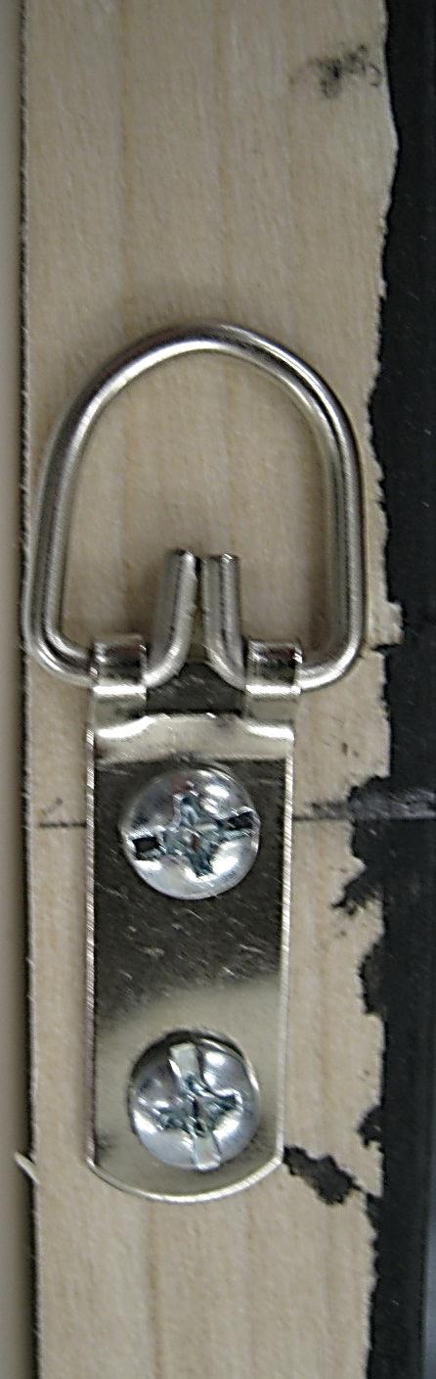
FRAMING HARDWARE
preferred are brass or nickel plated materials
framing hardware is attached before the sealed package is secured in the frame

Slide 24
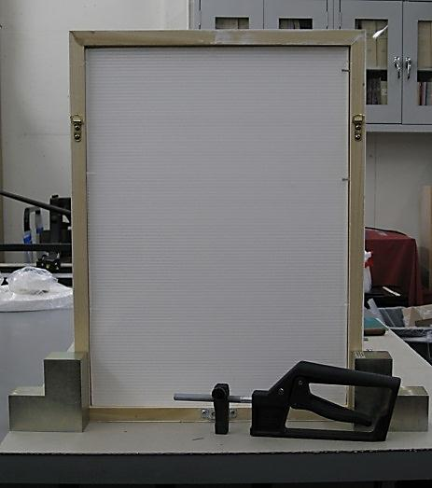
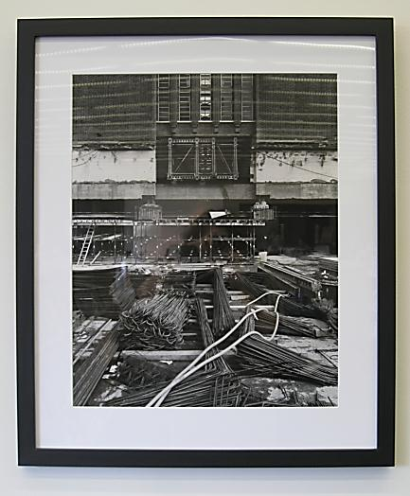
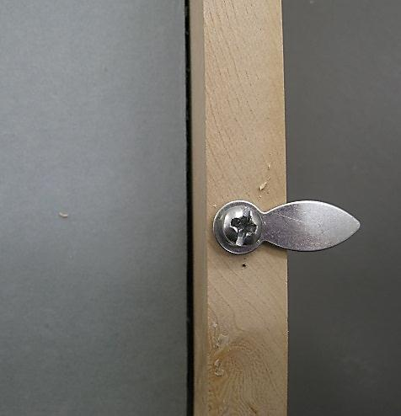
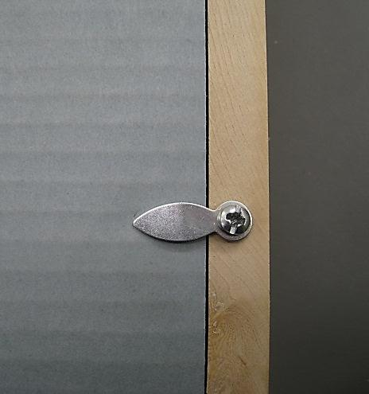
SECURING SEALED PACKAGE IN A FRAME
it is not advised to place frame with the hinged object face down
securing the frame with framer’s points could be performed while the frame is kept vertical
use of turn buttons is also advisable because they can be attached before the object is placed in the frame
Notes:
I use framer’s points for securing sealed package in a wooden frame. They are not museum standard but they are not damaging, rather cheap and easy to use. It is a good idea to keep the frame with the sealed package in it vertical when using points. Another option is turn buttons. They are great because they can be attached to the back of the frame before the object is placed in the frame. The only drawback is that you have to build up the thickness of your package so that it’s flush with the back edge of the frame.
I think I will stop here.

Slide 25
THANK YOU!
QUESTIONS:
IRINA GORSTEIN IGORSTEI@GSD.HARVARD.EDU
Notes:
I would like to thank everyone who came here today for your interest and patience. I also want to thank all the people that I learned from over the years and many of whom are here today and especially Debora Mayer of the Weissman Preservation Center for helping me with today’s presentation. I also want to thank the GSD Exhibitions Department for making things happen.

