Slide 1
Preparation of Library Materials for Exhibit
Planning and Layout
Notes:
Good morning! Happy May Day! I will talk about…but first want to emphasize that the four of us will each be presenting out topics from the perspective of our libraries…or museums. My talk will touch on some of the general ideas in planning and layout. Some of you are probably familiar with these, but this is an opportunity to share some of our ideas.

Slide 2
Types of Materials
Books
  Scrapbooks
Manuscripts
Photographs
Posters
Clothing
Memorabilia/ephemera

Slide 3
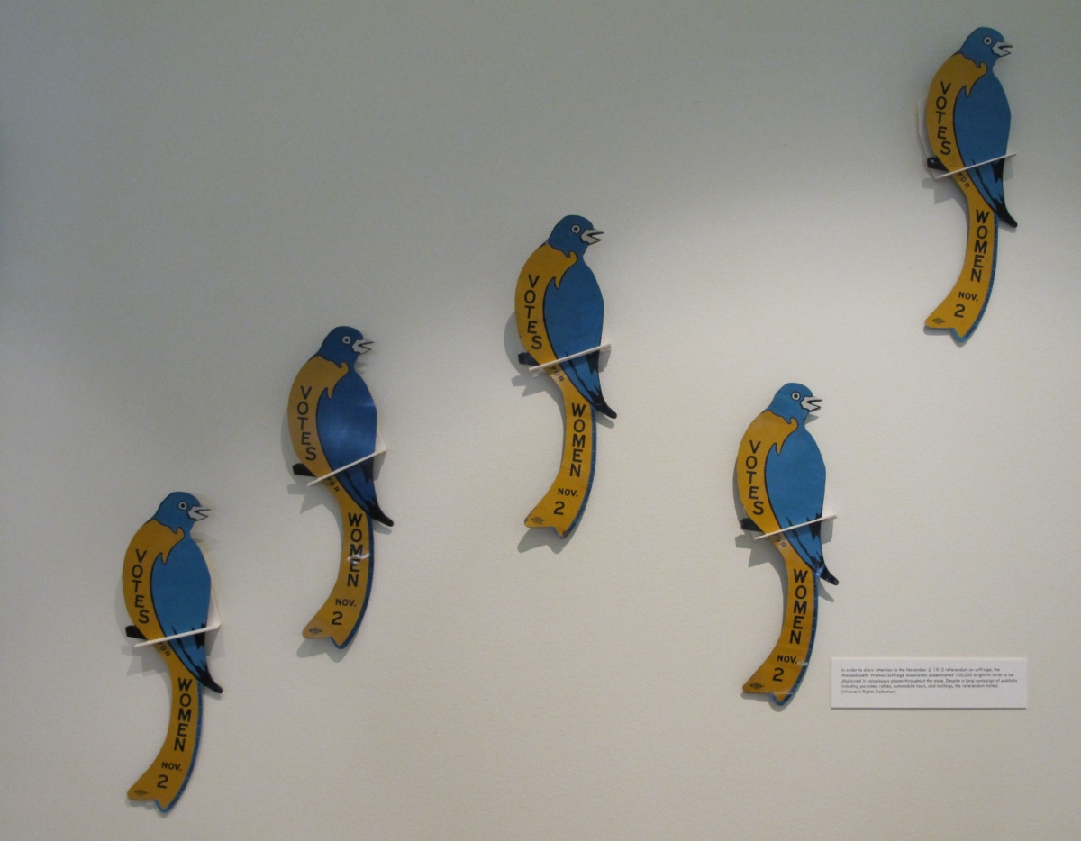
Blue Birds, Massachusetts Woman Suffrage Association, 1915
Unusual format and material
Notes:
100,000 throughout state to draw attention to referendum. An example of unusual format found in library collections. Rather than string the birds around the neck, I had to come up with a roost for them—these are fabricated from mat board and vivak—a polyester material I will talk about later.

Slide 4
Why exhibit?
Show off collections
Donor relations
Special events, conferences
Faculty, researchers, students, visitors
Staff involvement, camaraderie
Support the teaching mission of the institution

Slide 5
Who is involved?
Committee: manuscript processors, book catalogers, curators
Conservation: support the exhibit team by making sure materials are displayed safely and thoughtfully
Administration
Faculty and students
Notes:
My job is to support the exhibit team. Admin is involved because of reception, publicity

Slide 6
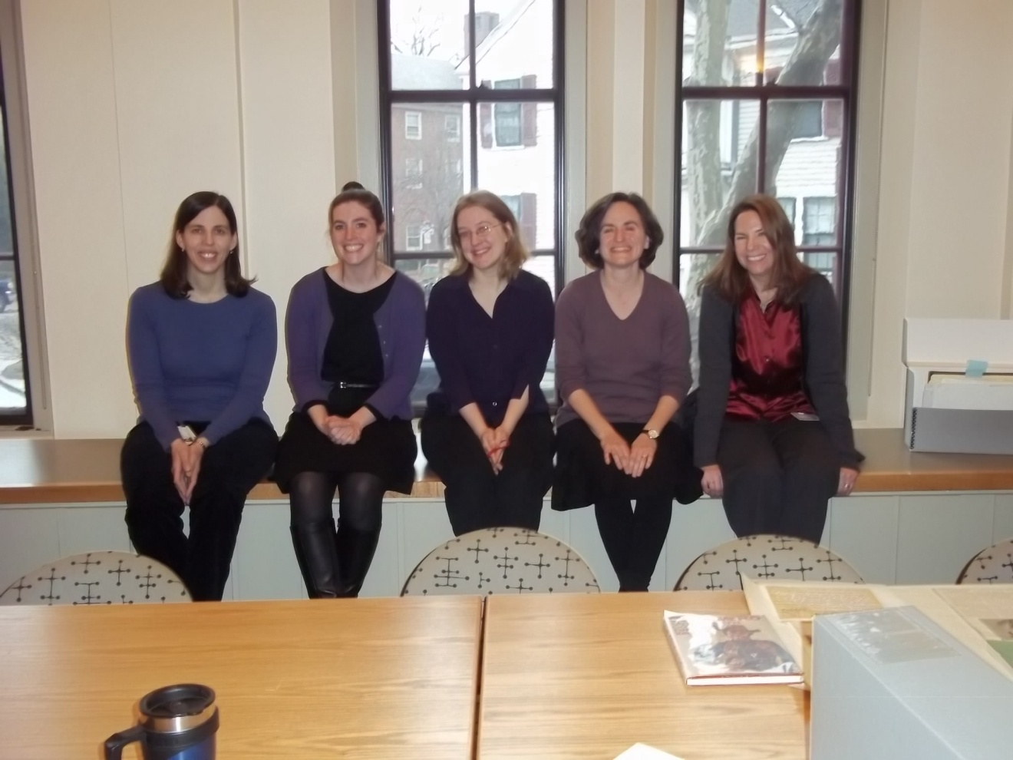
Exhibit team
Notes:
Here’s the team for the current exhibit…missing a couple. Paula, Katie, Summer, Laura and Stacey.

Slide 7
How does exhibit function?
  Display objects as art?
  Display to show depth of collections?
      Genres
      Time periods
      Various media

Slide 8
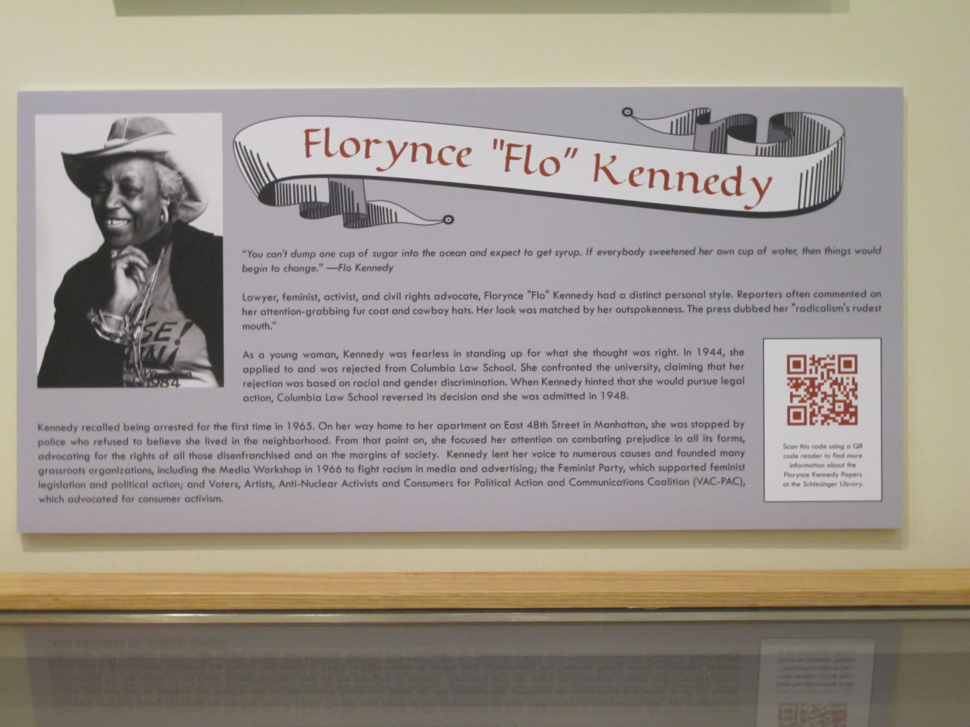
Exhibit panel helps to remove text from display of objects
Notes:
This is an exhibit panel from our current exhibit. Even though this is text heavy, if one wants more info, we have incorporated a QR (quick response) code in the panel.

Slide 9
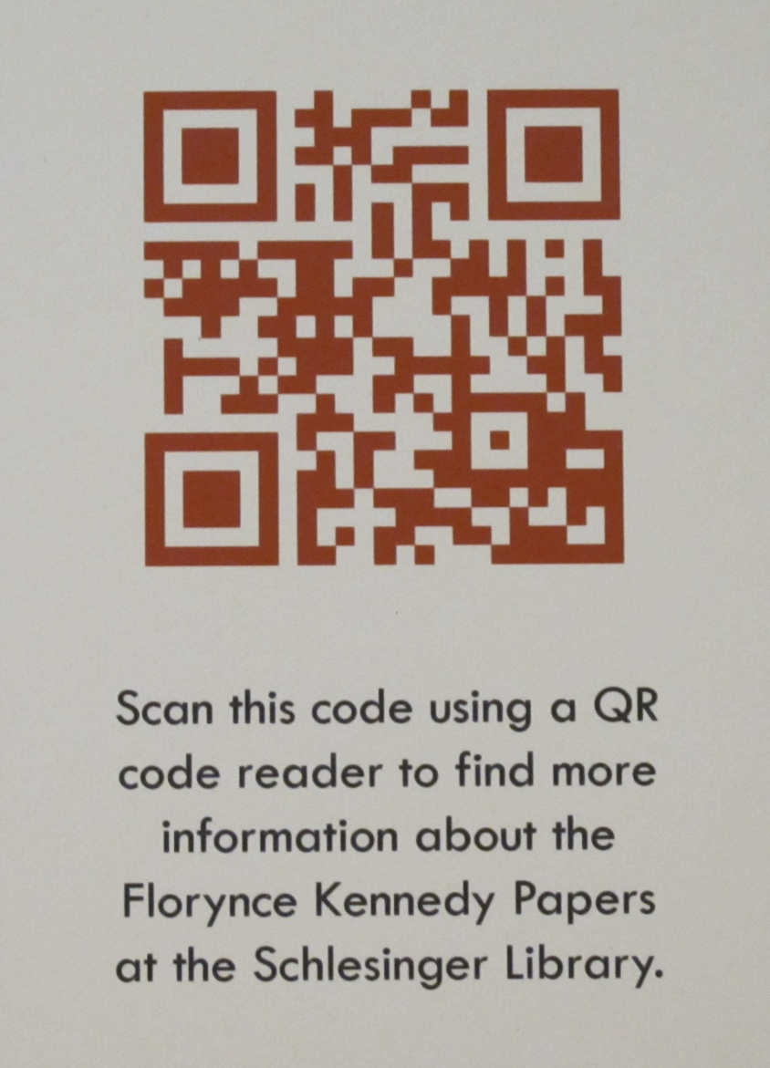
QR code from exhibit panel, provides link to finding aid

Slide 10
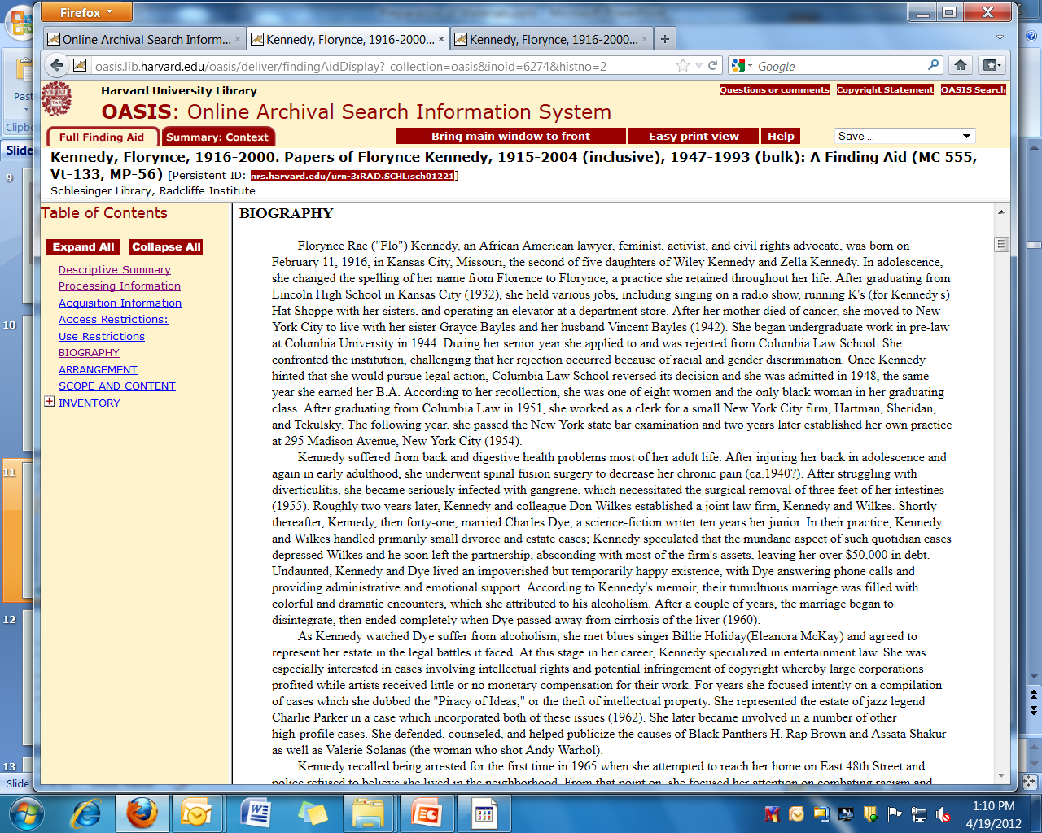
Excerpt from Florynce Kennedy Papers finding aid
Notes:
Example of SL finding aid link. A goal is to minimize text in the cases. At Music Library, there are links to music, etc…

Slide 11
Timeline factors
Vary from library to library
Exhibit committee formed 6 months ahead opening
Loaned materials?
Conservation treatments?
Preparation of item supports for display
What other projects are going on at same time?

Slide 12
More time=More options

Slide 13
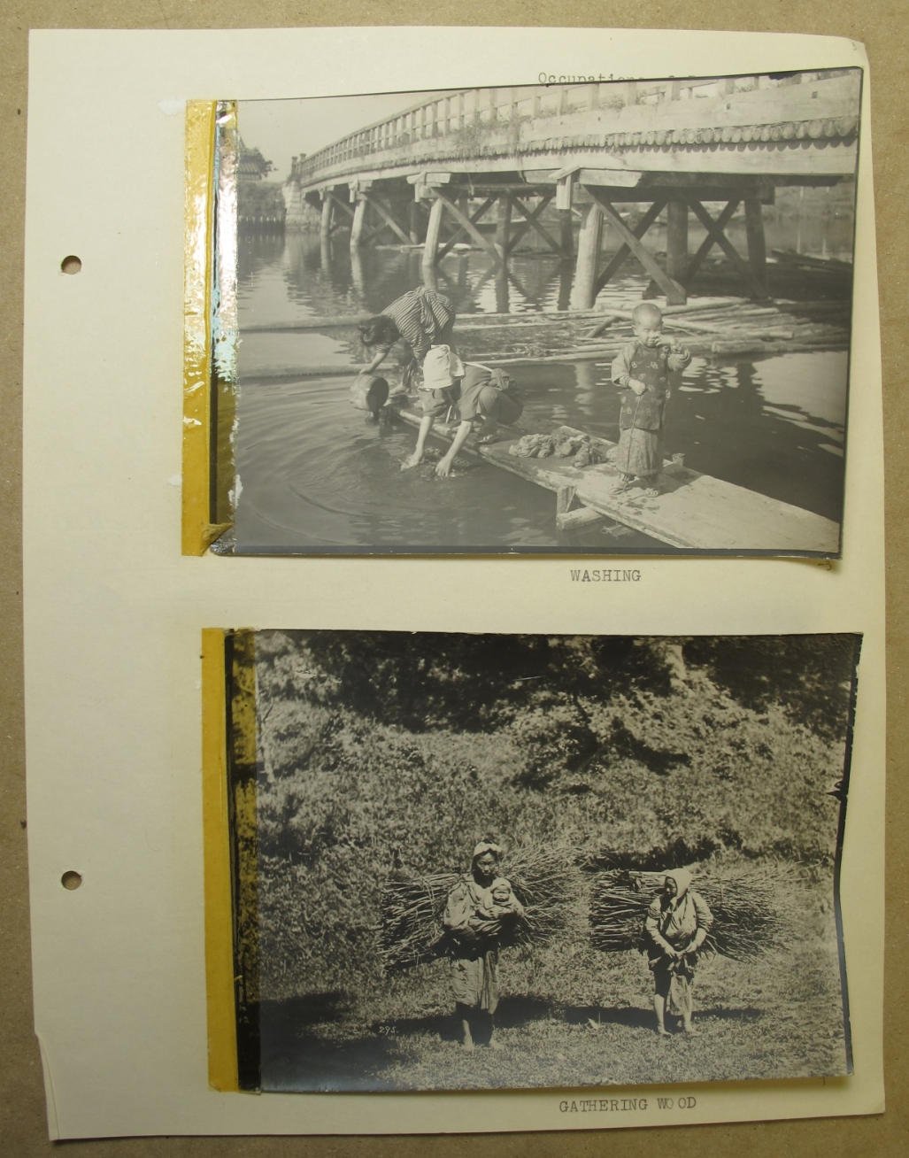
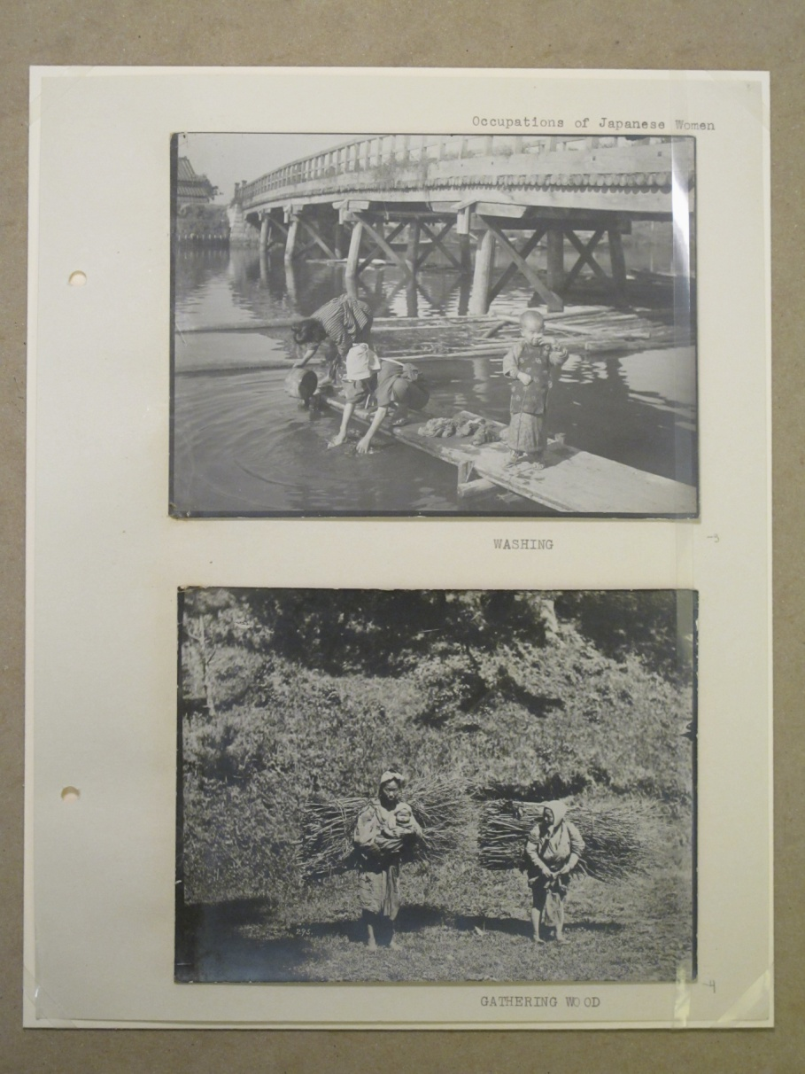
Photos of Japanese women, ca. 1909-1911.
From the papers of Maud Wood Park.
Notes:
Describe this. The pressure sensitive tape on the left is distracting. Because I had time to remove it, I did, which improved the appearance.

Slide 14
Countdown
Selection of items for cases and walls finalized
All items requiring treatment to conservator
Content ready for a/v component
All items for support preparation
Case panel text to library directors and/or curator
Graphics to printer
Caption text mounted
Old exhibit taken down
Patching/painting
MOUNT EXHIBIT
Notes:
AV component—touch screen in the exhibit area. Materials are selected at the library and brought to the Media Preservation Center.

Slide 15
Shapes
LAYOUT PLANNING USING PAPER TEMPLATES
20”
6” Back Height
3” Front Height
49”
Height 8”
Sizes
12”
Notes:
Cut out paper templates exactly the size of the cases, with height allowances written.

Slide 16
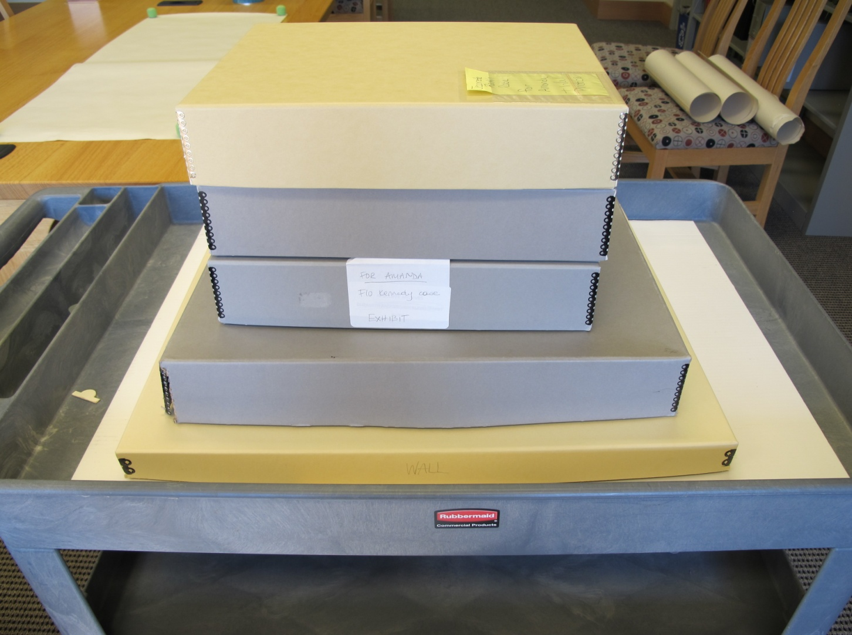
Each case has a box for temporary housing of display items

Slide 17
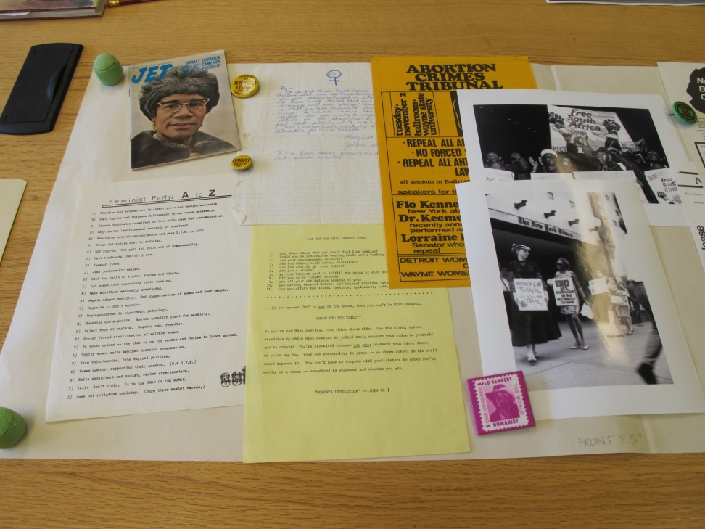
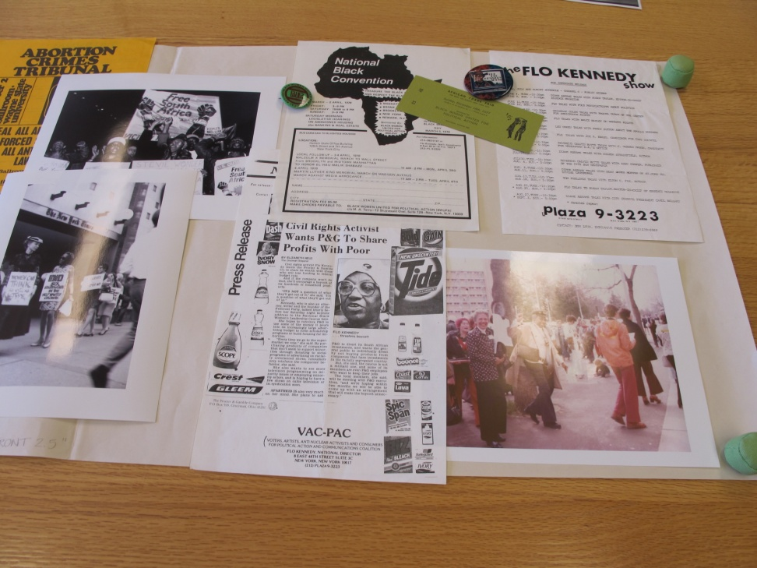
ROUGH LAYOUT
Notes:
This is what I see. Are all items necessary to narrative? Can some sizes of items be adjusted through scanning? Take a quick photo of the layout, or a simple pencil sketch of item placement.

Slide 18
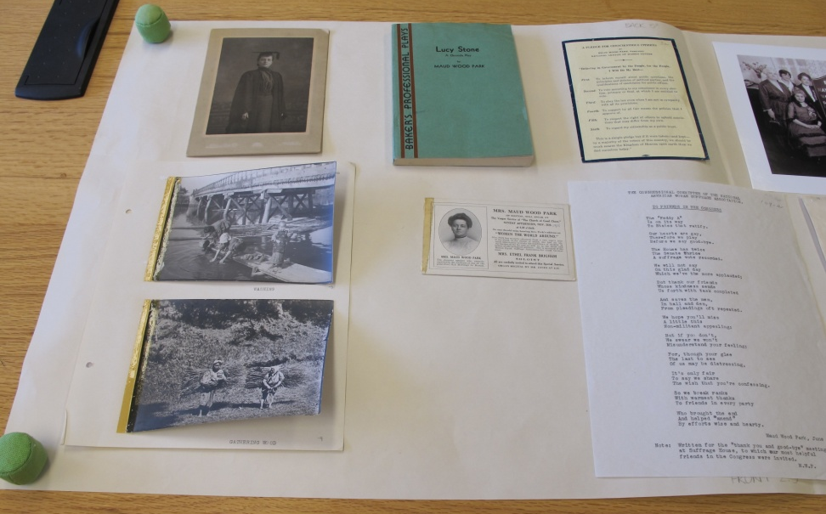
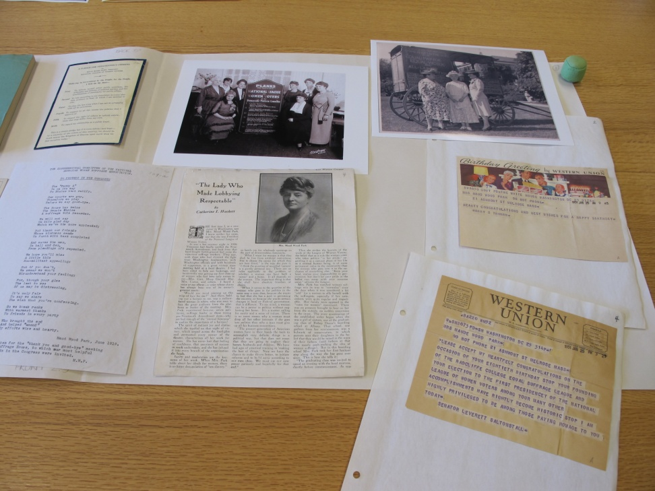
ROUGH LAYOUT

Slide 19
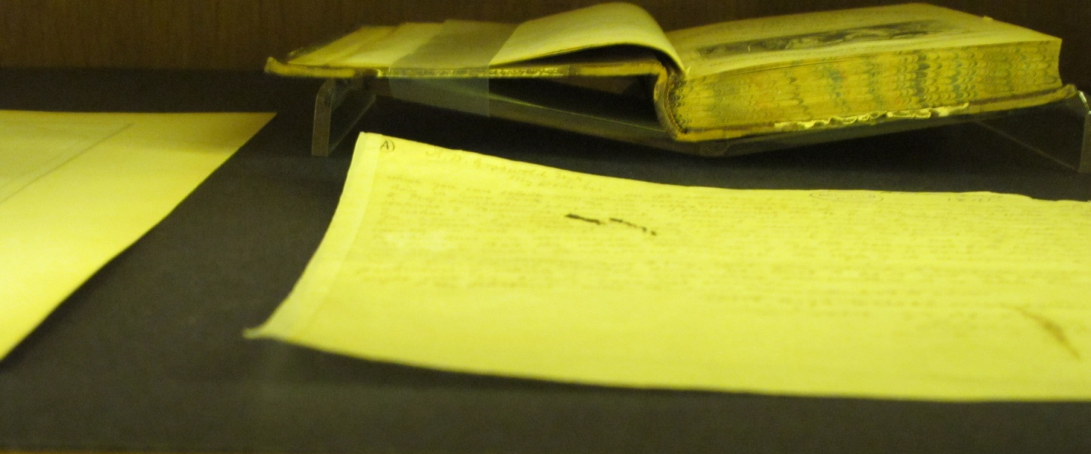
Material must be secured
(Not a Harvard Library)

Slide 20
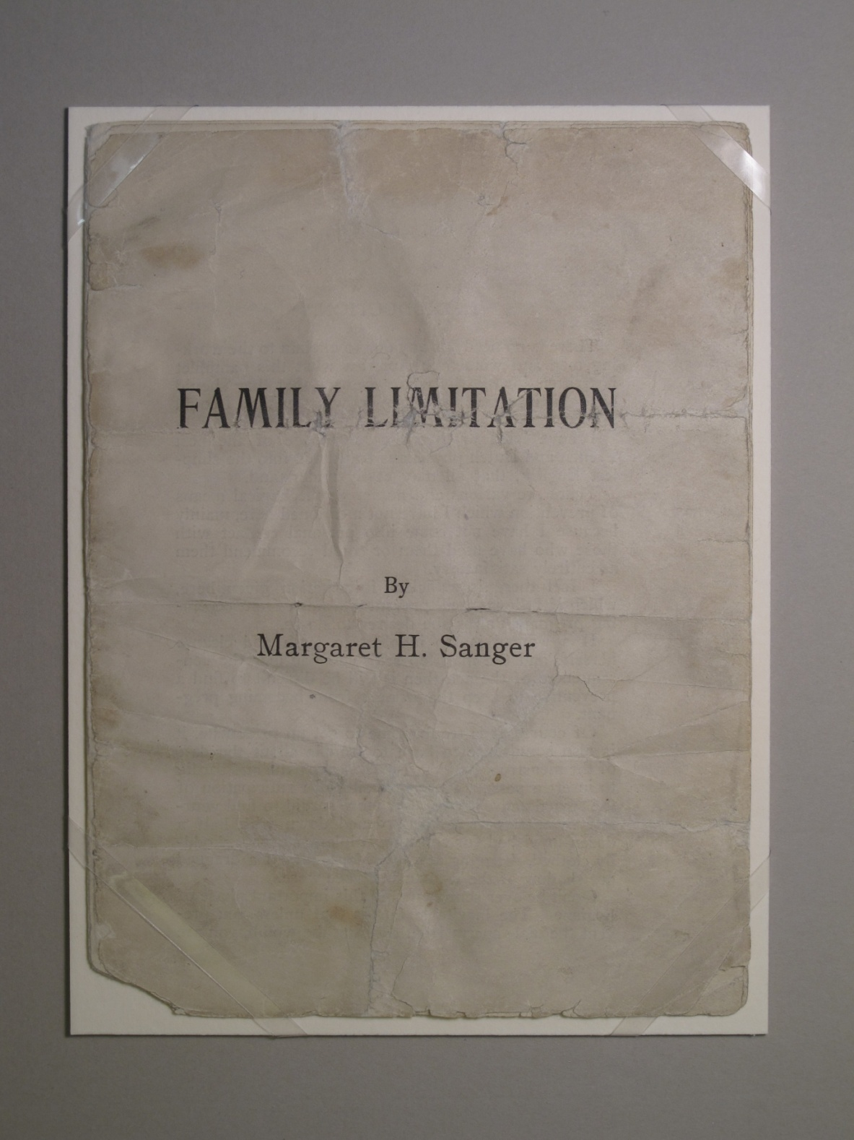
[Emma Goldman]
Emma Goldman’s copy
Notes:
Debora Mayer. This sad looking pamphlet is Emma Goldman’s copy of Margaret Sanger’s contraband birth control pamphlet. It is vital to retain the quality of use shown here, but the simply mounting makes this pamphlet look cared for and the display of it purposeful. Simply polyethylene STRAPPING.

Slide 21
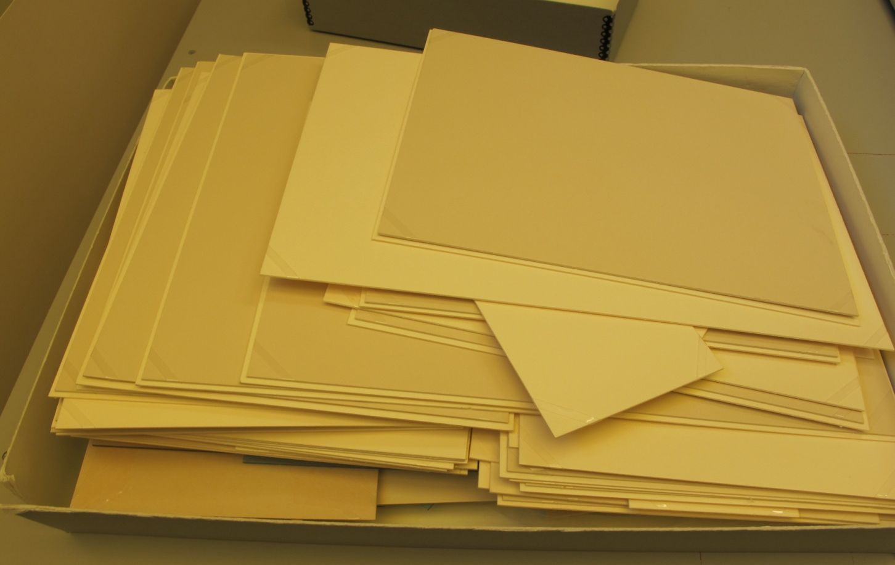
Reuse of mat board—
Green practice
Saves $$
Limited palette

Slide 22
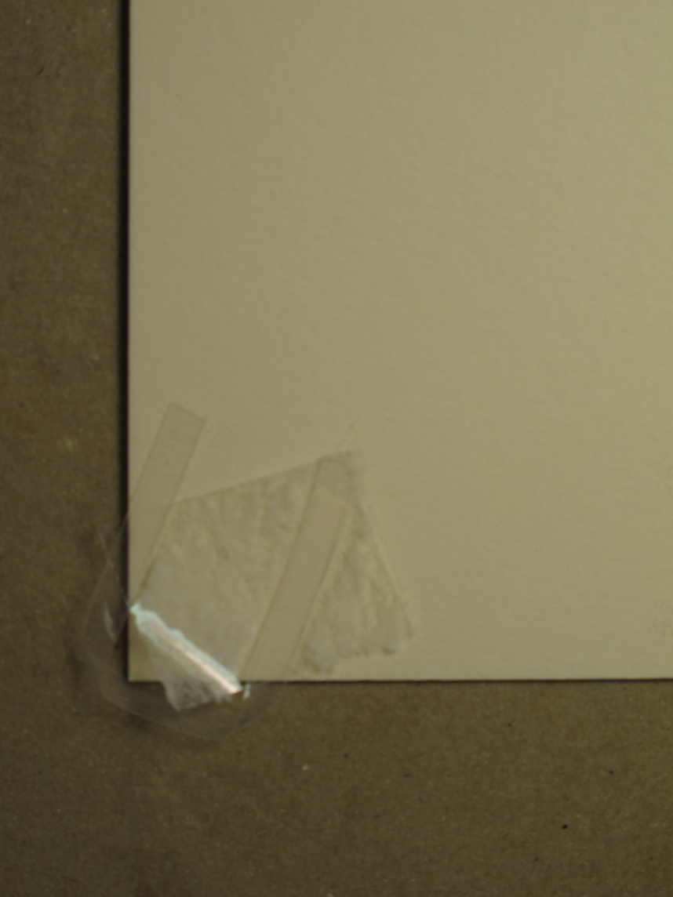

Caution: pay attention to strapping, tape residue
REUSED MAT BOARD
Notes:
Because everything is mounted, the material can be handled safely while setting up the exhibit.

Slide 23
Labels
Don’t want labels to overpower objects
  Size
  Visual impact
Sympathetic typography, or not?
Font size (ADA requirement 18 pt.)
Notes:
At SL, monochromatic items—that is gray—can be visually overwhelmed by labels. Keep in mind.

Slide 24
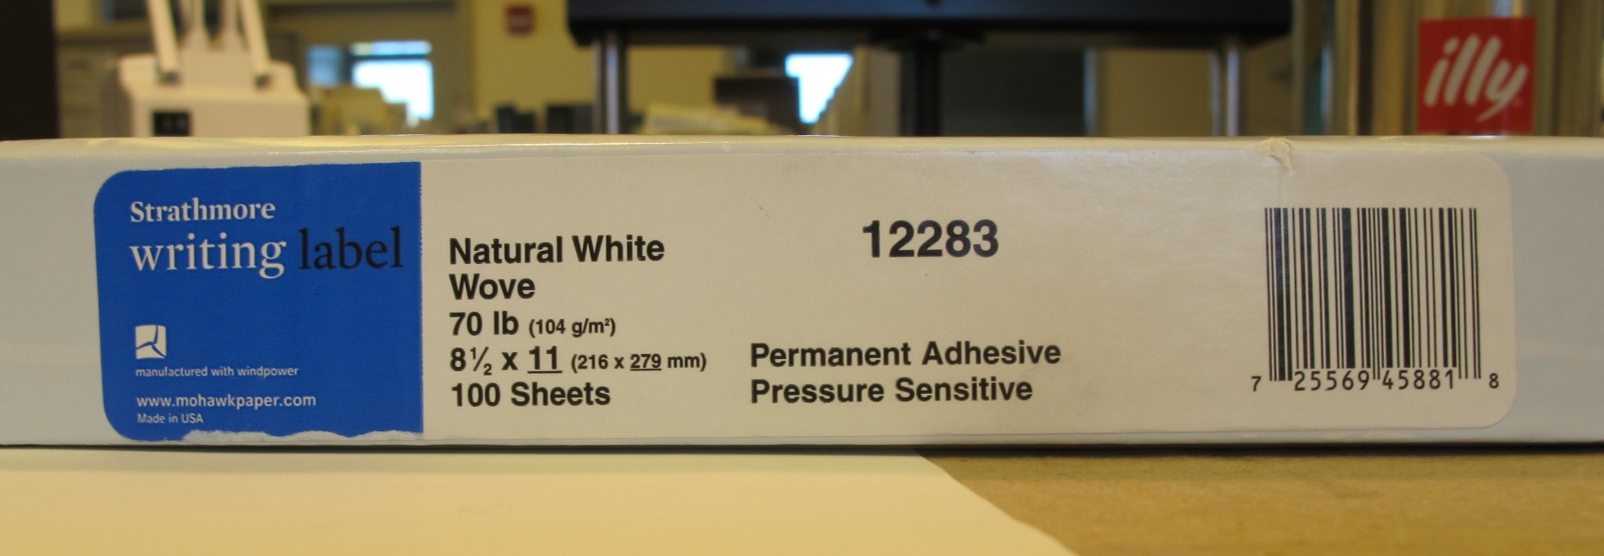
Mounting Labels
Notes:
I like to mount labels on mat board. This is an easy way. Hold up sample with vivak SPACER. Show vivak SPACER.

Slide 25
VIVAK
    Thermoplastic polyester sheet
    Inert
    Thickness= .06o”
Clear and unobtrusive, but still best not to see it—glare
Folds keep shape
Cut to size
Adaptable—shapes and sizes
Not best choice for large, heavy volumes
Reusable and recycleable
Notes:
Cut it with board shears and clamp it in job backer.

Slide 26
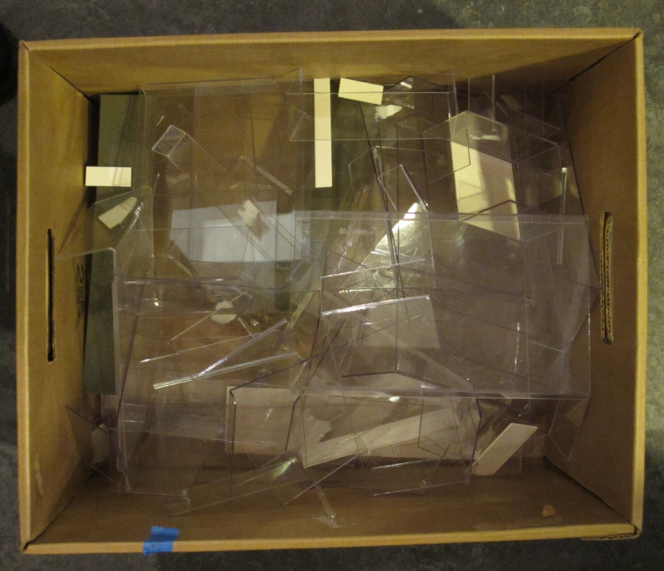
CARTON OF VIVAK
Notes:
Keep vivak scraps for supports for objects and labels. Irina told me that this can be recycled now…

Slide 27
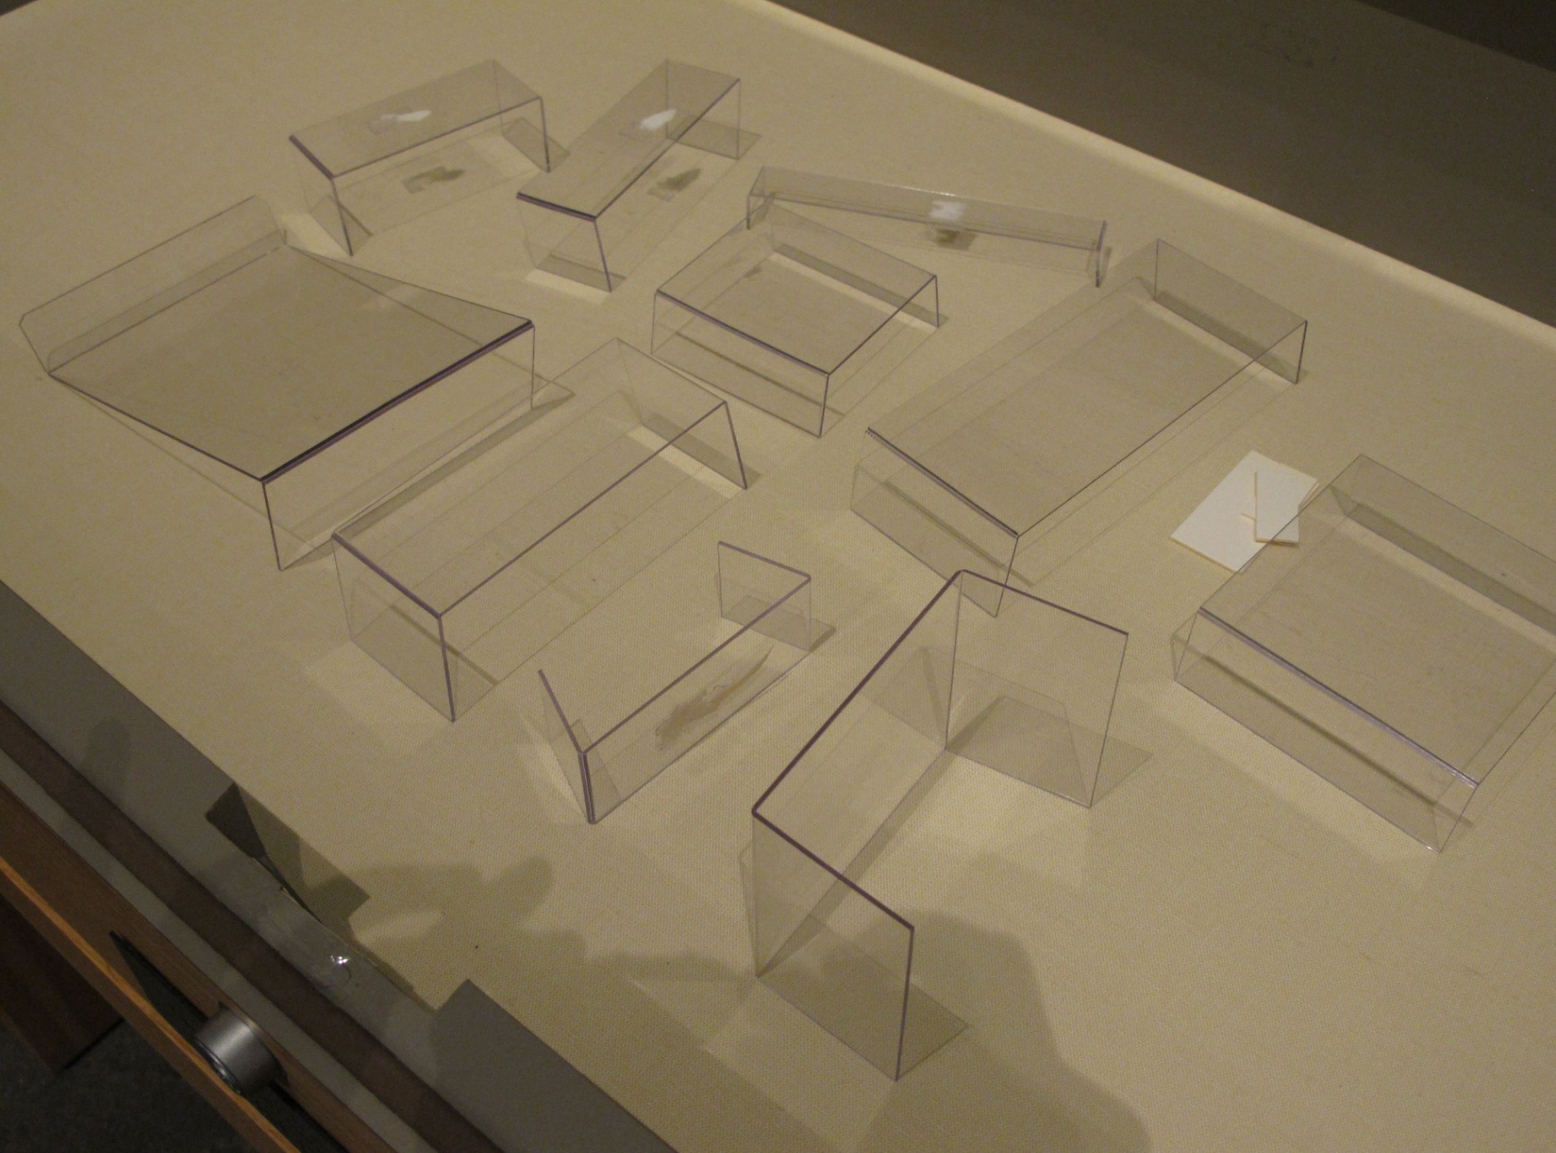
VIVAK SUPPORTS
Notes:
Use various supports to create differences in height for objects or labels …or both

Slide 28
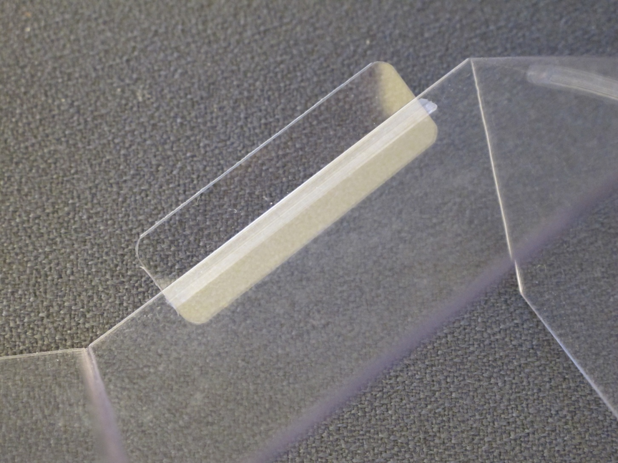
Watch sharp points on Vivak
Notes:
Priscilla will talk more about cradles. Show mine. Pay attention to sharp corners—calfskin binding, for example

Slide 29
LAYOUT DESIGN RESTRICTIONS
Physical Space
Narrative of objects
Notes:
Narrative of the objects is particularly important in displays with a historical focus

Slide 30
CONSIDERATIONS
Smaller items closer to viewer
Items with fine text closer to viewer
Spacing decisions
Liveliness
  Angled cradle vs. flat
  Variation in height
Notes:
Use of SPACERS to help train eye

Slide 31
Where and how does average viewer see items?
  Angled items towards back, for example
Symmetry or asymmetry
Visual weight—where is eye drawn?
  Color
  Size
  Detail

Slide 32
Balance

Slide 33
How to achieve balance?
Start with larger items
Soft focus
Consider case as a whole rather than individual objects
Take advantage of differences in height
Notes:
Soft focus or even shut eyes?

Slide 34
Clarity
Ideally, labels are placed consistently relative to object

Slide 35
In a crowded case, labels should be placed so that viewer can immediately determine corresponding object.
Notes:
Compromises are necessary but

Slide 36
SURROGATES
In displaying original objects, there are conservation/preservation considerations:
  sensitivity to light—and bear in mind that some papers or media or particularly vulnerable, i.e. wood pulp paper or watercolors. (WPC has light meters and can help assess light conditions.)
  inappropriate and/or fluctuating temperature and humidity
  security concerns

Slide 37
SURROGATES
SL tries to use original where possible but sometimes surrogates are required:
  Vulnerable items
  Space limitations
  Clarity—larger scans for small text or photographic detail
  Finishes consistent: glossy; matte
Best to acknowledge in caption that item is digital print

Slide 38
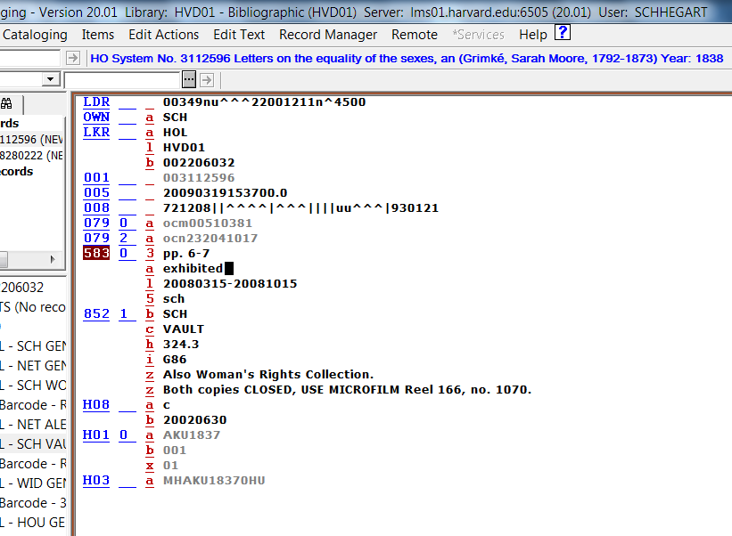
RECORD KEEPING
Note exhibit history in
583 field of MARC record

Slide 39
MAINTENANCE
If you have original layered material, keep an eye out for differential fading. Such fading is an overt warning that the material is light sensitive and a surrogate should be substituted.

Slide 40
MAINTENANCE TASKS
Is strapping secure?
Any shifting?
Change book openings?
Dust
Notes:
Flo’s hat (dusting)and exhibit area location (lockers)

Slide 41
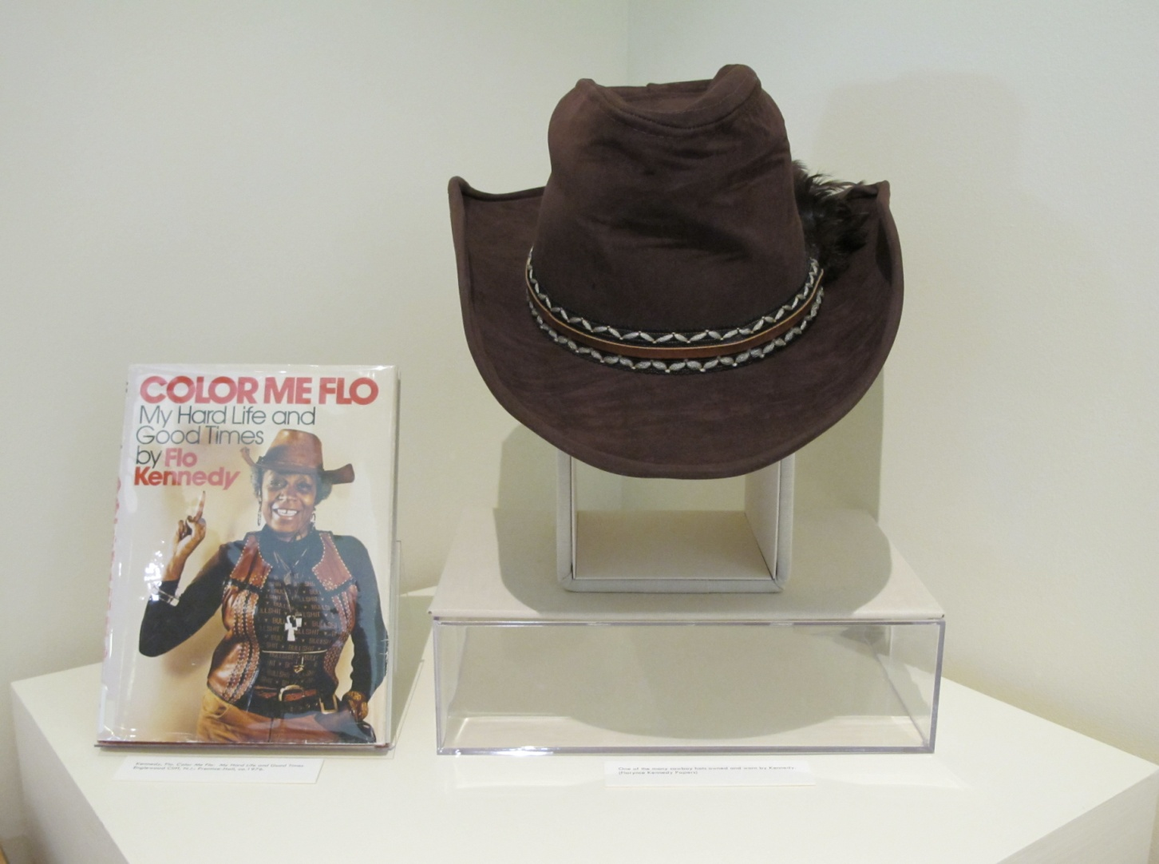

Slide 42
FUTURE EXHIBIT IDEAS
Charlotte Perkins Gilman (150 year anniversary of her birth 2010)(AH)
Travel diaries: then and now
Harriet Beecher Stowe (Bicentennial of her birth 6/1811)(DF/AH)
“Games People Play: a historic look at women and recreation” (JT)
Dorothy West, Harlem Renaissance (JD)
Things found in books (Ephemera) (ST)
Notes:
Staff involvement. I maintain a list that staff add to when they have idea. We try to incorporate anniversary information, etc. This is example.

Slide 43
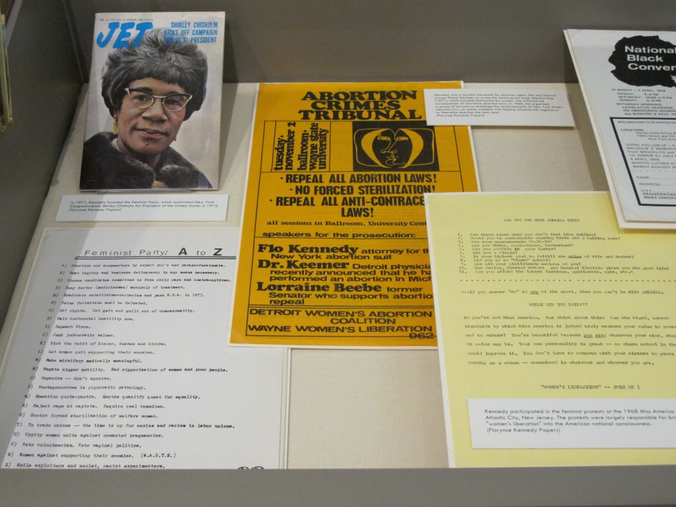
LAYOUTS
Initial layout
Final layout
Notes:
I will run through some before and afters as well as slides of previous exhibits. Feel free to comment or make a suggestion.

Slide 44
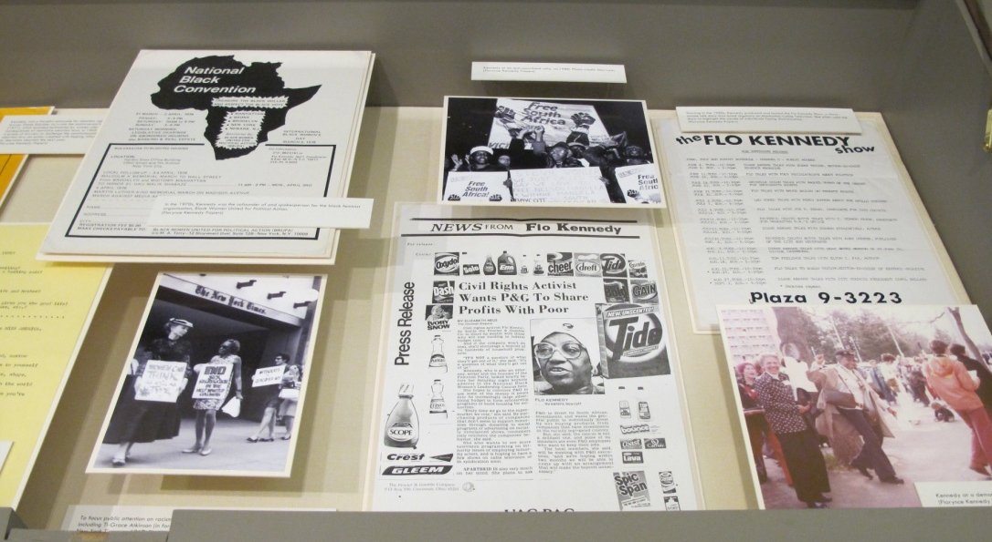
LAYOUTS
Initial layout
Final layout

Slide 45
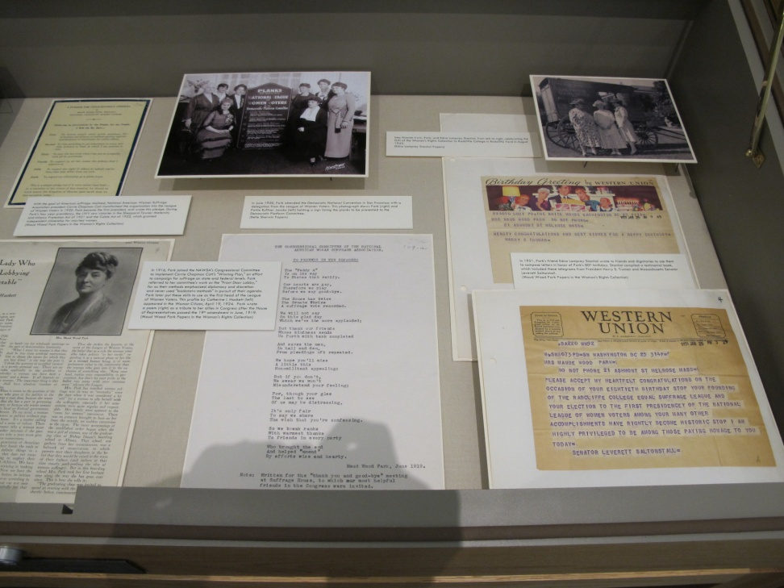
LAYOUTS
Initial layout
Final layout

Slide 46
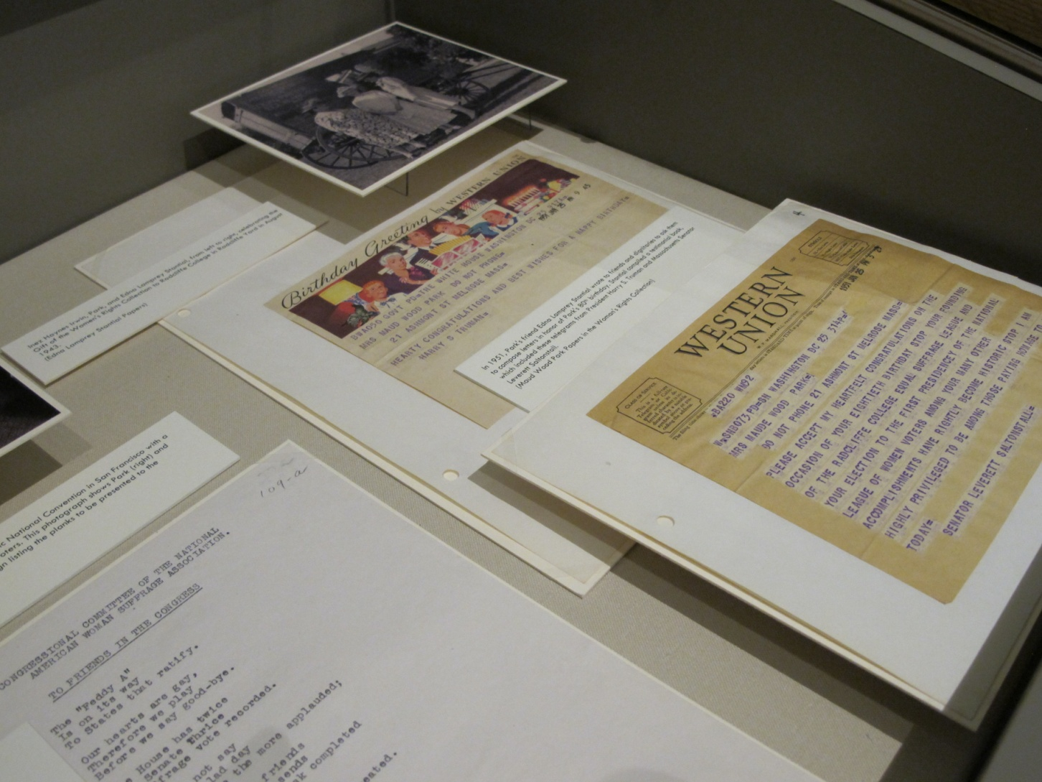
Notes:
Upper right—would not see the vivak. Shadows help to create depth, which makes the flat objects a bit more lively.

Slide 47
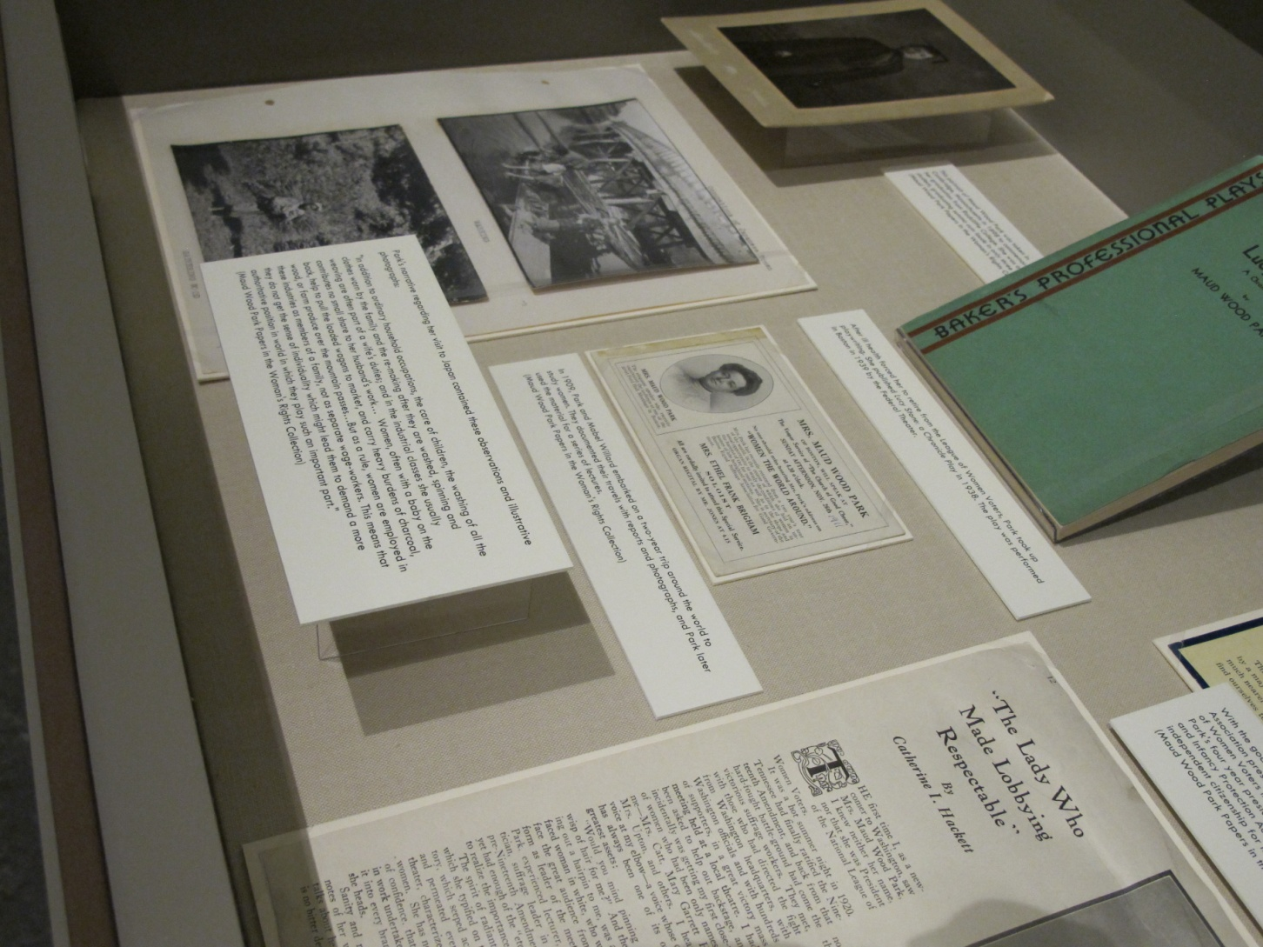

Slide 48
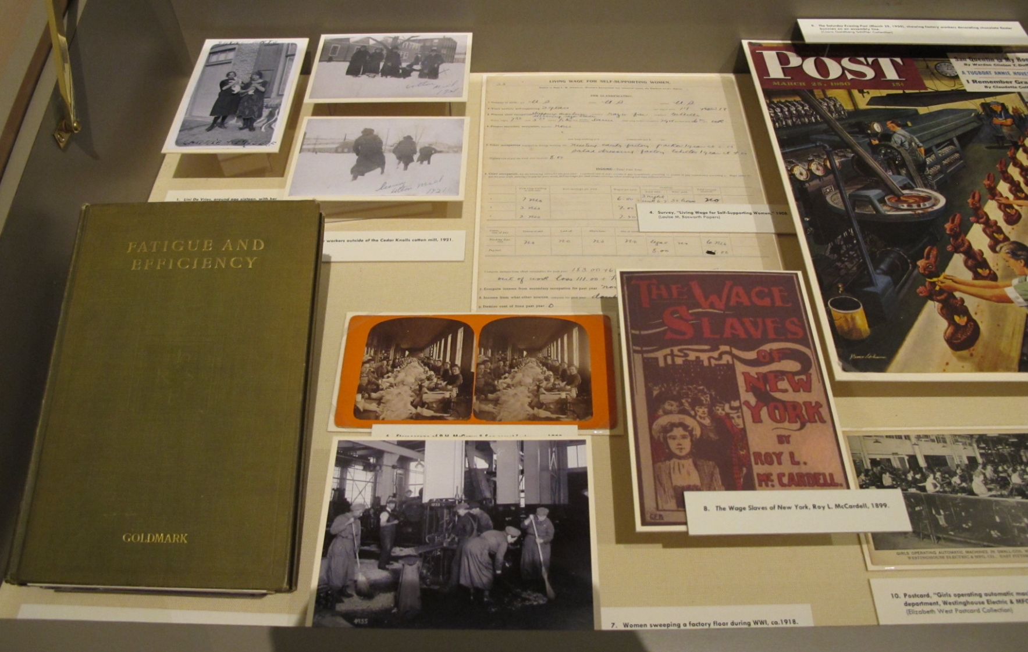

Slide 49
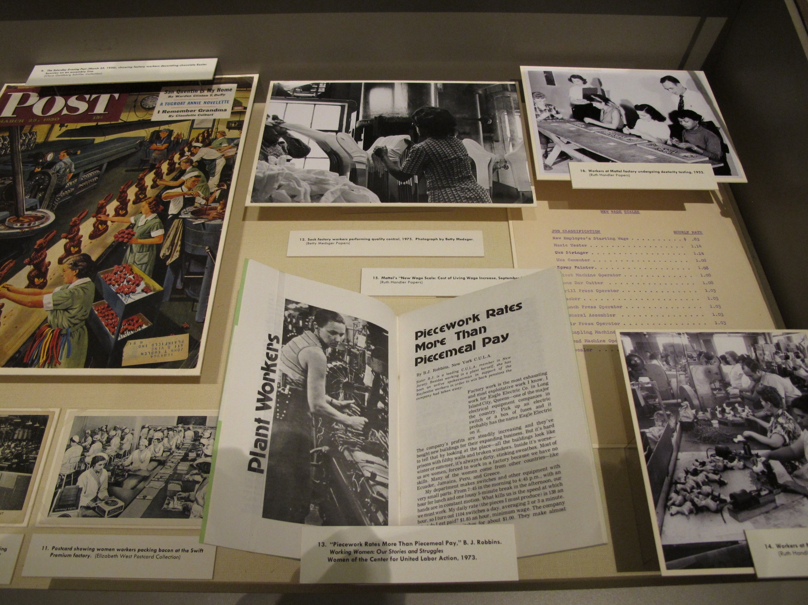

Slide 50
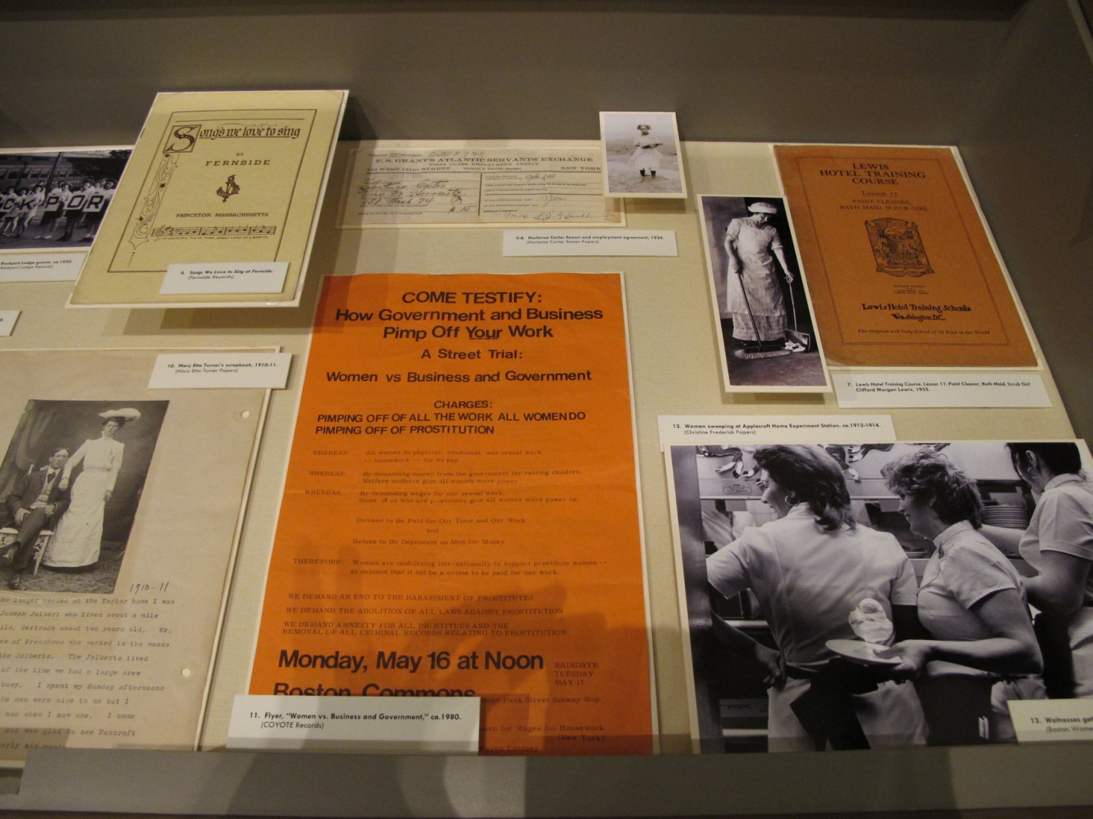

Slide 51
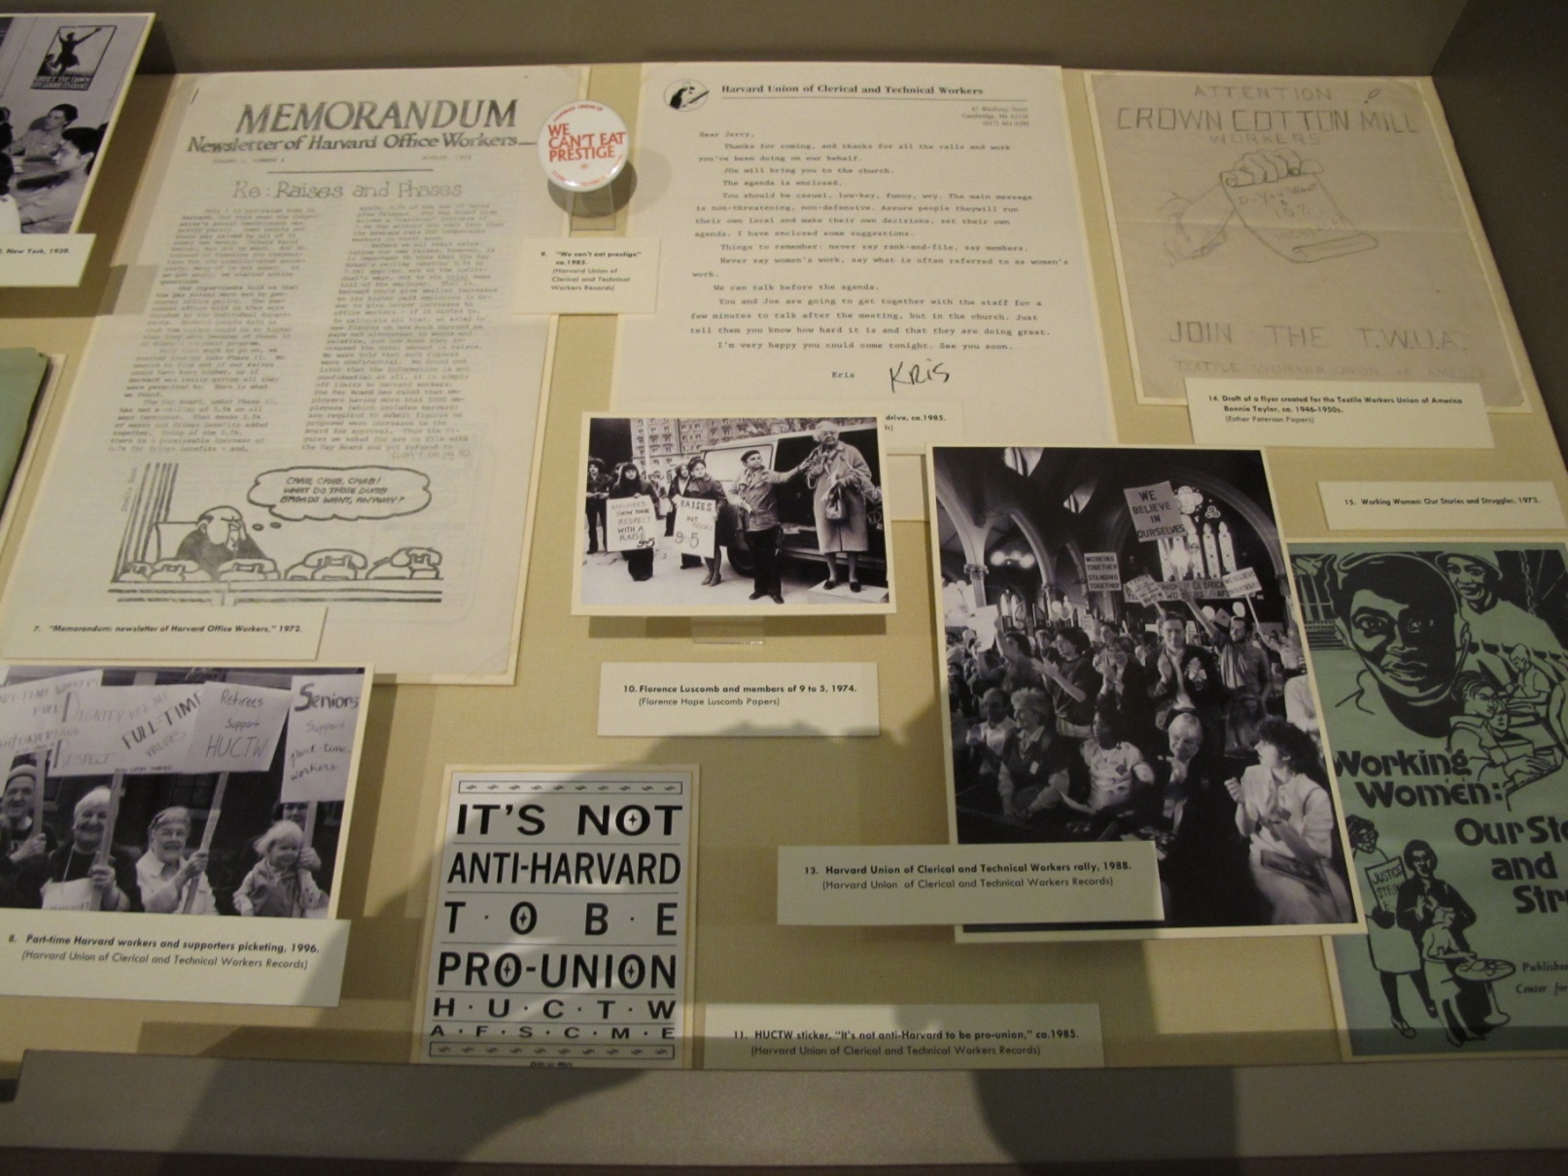
Notes:
Close with HUCTW

Slide 52
Thanks for coming!
Amanda_hegarty@radcliffe.edu

